Slide 1

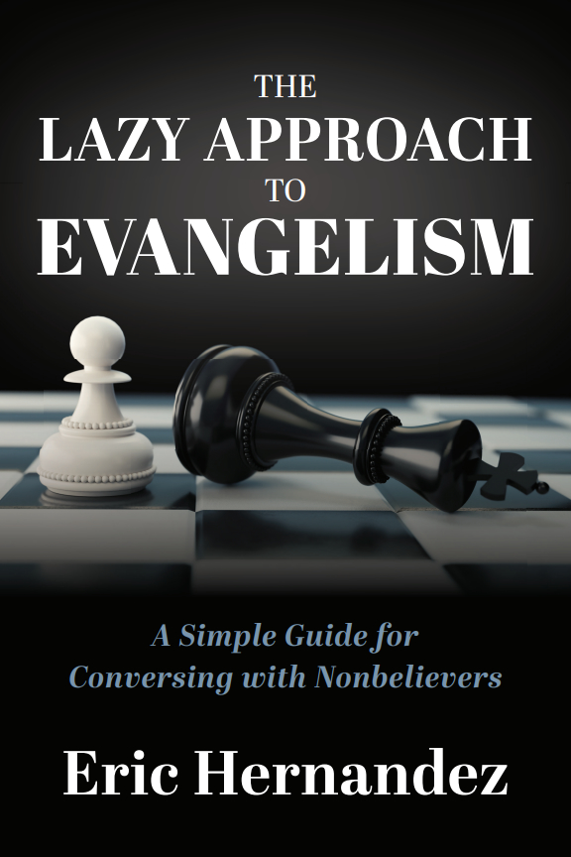


EhmApologetics.org

Slide 2
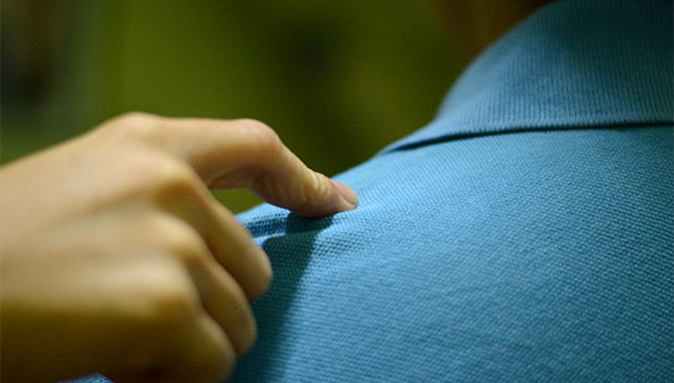

“HAIL SATAN!”

Slide 3

And how does that prove God does not exist?
What evidence do you have that God does not exist?
The Bible is FULL of contradictions!

Slide 4

“Put a stone in their shoe”

Slide 5

“Put a stone in their shoe”

Slide 6


Evangelism
Gardening
Harvesting

Slide 7
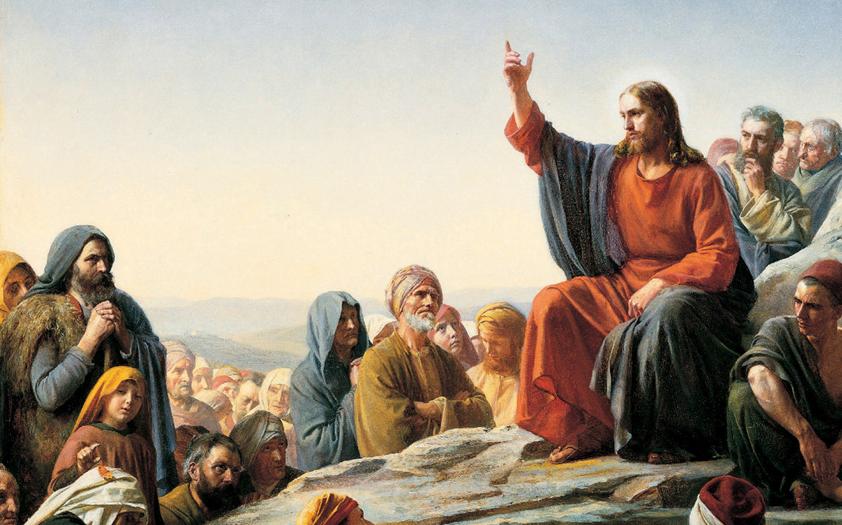
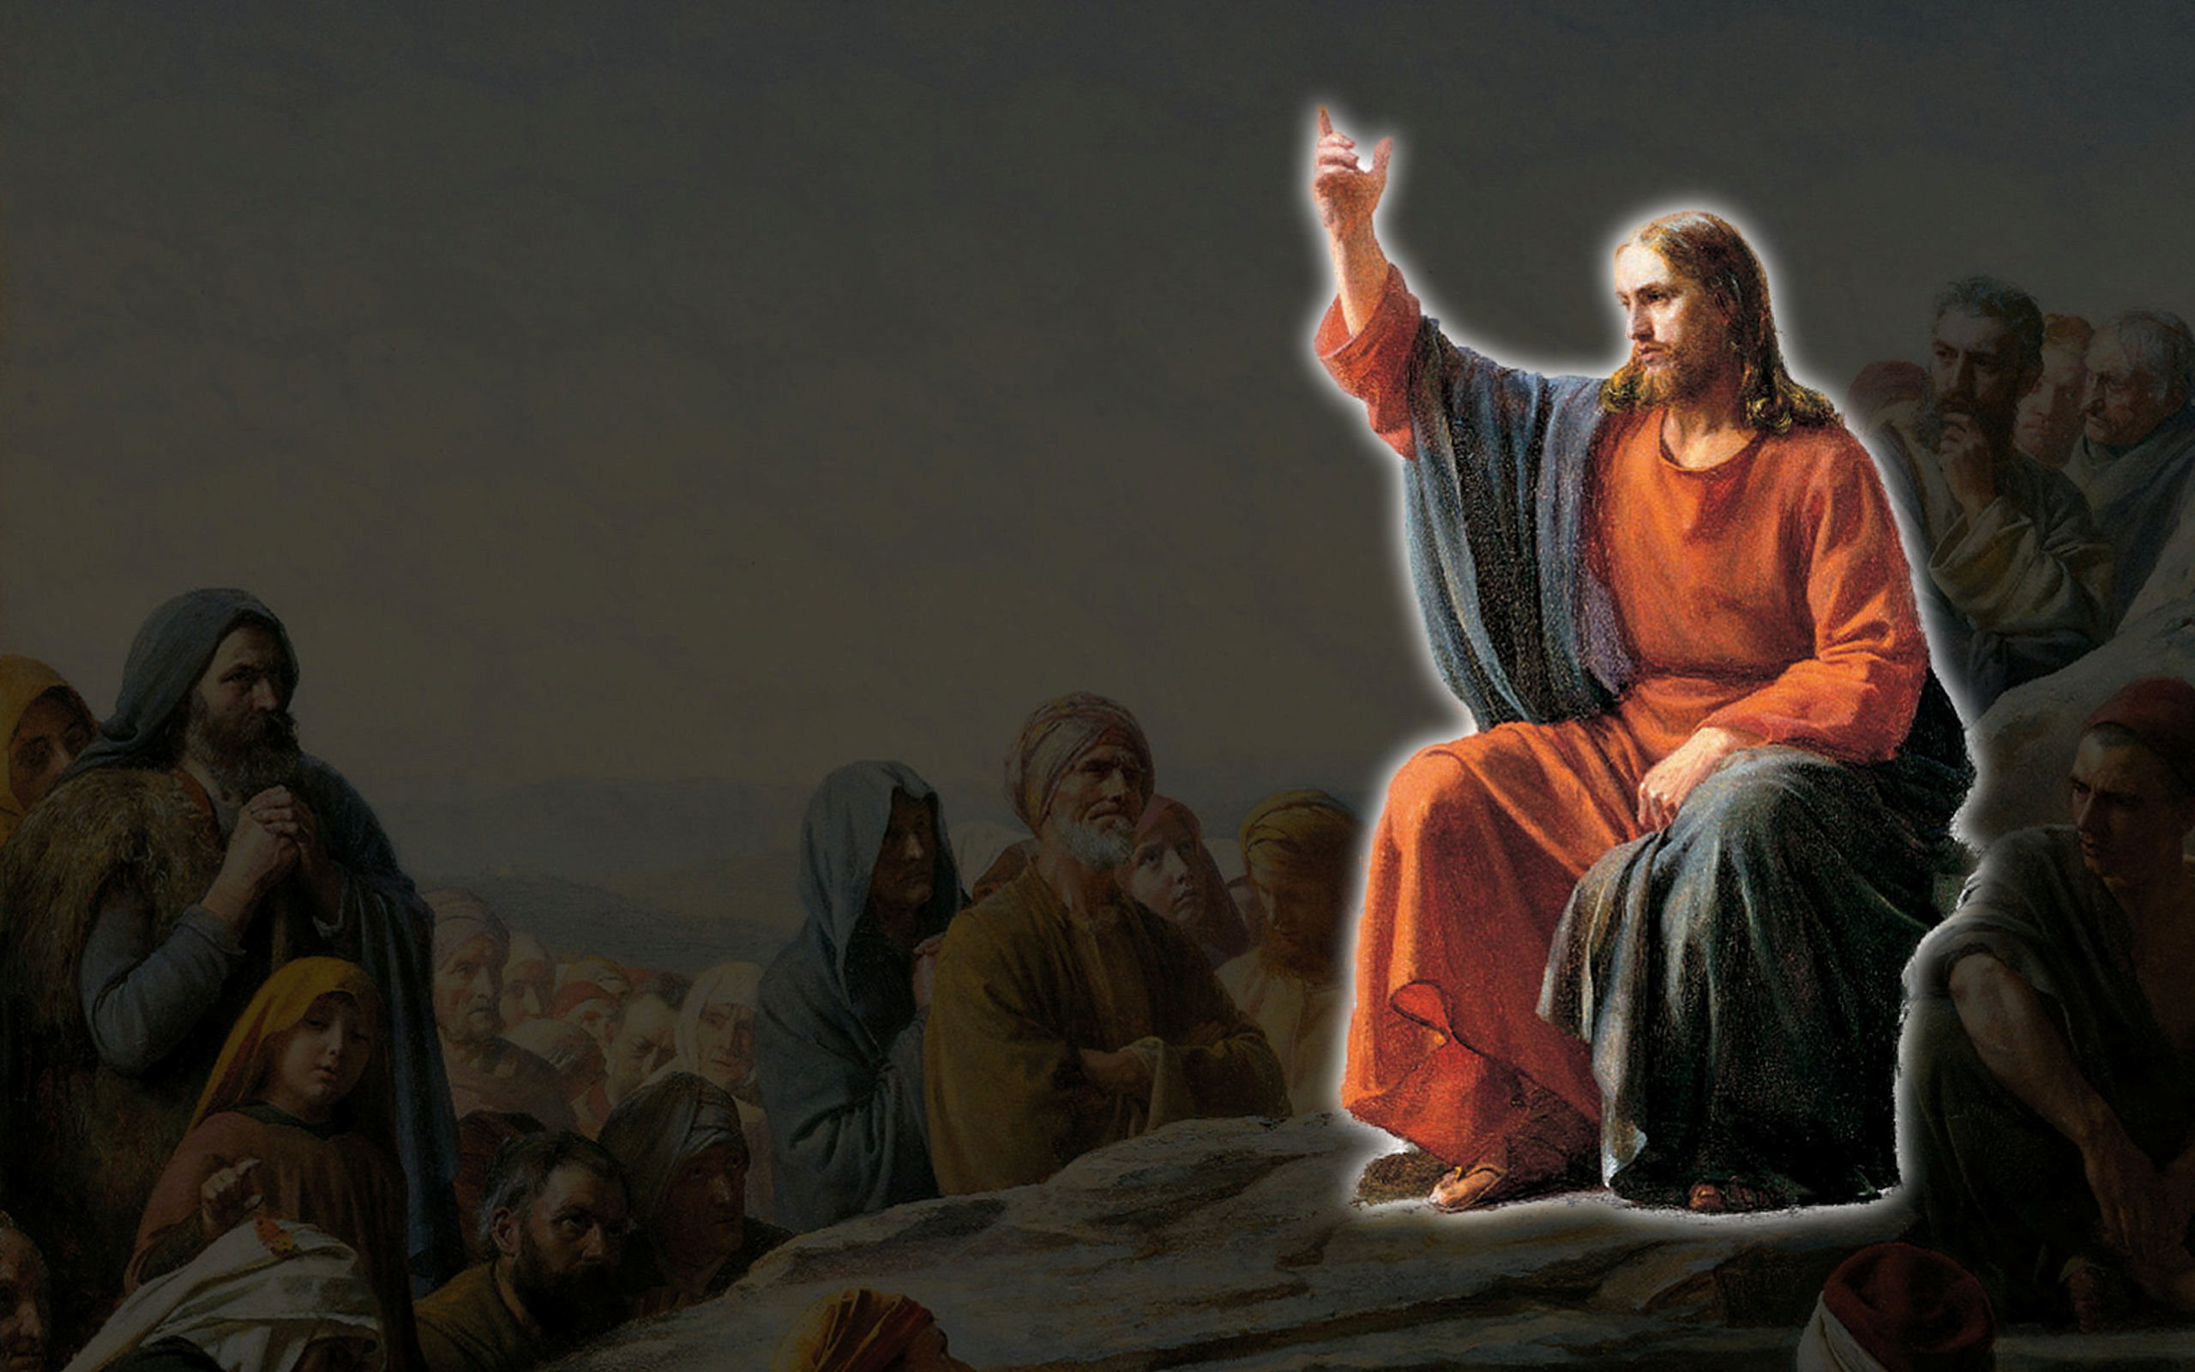
Thus the saying “One sows and another reaps” is true. I sent you to reap what you have not worked for. Others have done
the hard work, and you have reaped the benefits of their labor.
- John 4:36-38

Slide 8




Evangelism
Gardening

Slide 9
So that the sower and the reaper may be glad together
- John 4:36-38

Slide 11

Conduct yourself with wisdom in your interactions with outsiders (non-believers), make the most of each opportunity [treating it as something precious]. Let your speech at all times be gracious and pleasant, seasoned with salt, so that you will know how to answer each one [who questions you].
Colossians 4:5-6
2 Biblical Principles
Keep the Main Thing THE Main Thing

Slide 12
Conduct yourself with wisdom in your interactions with outsiders (non-believers), make the most of each opportunity [treating it as something precious]. Let your speech at all times be gracious and pleasant, seasoned with salt, so that you will know how to answer each one [who questions you].
Colossians 4:5-6
Conduct yourself with wisdom in your interactions with outsiders (non-believers), make the most of each opportunity [treating it as something precious]. Let your speech at all times be gracious and pleasant, seasoned with salt, so that you will know how to answer each one [who questions you].
Colossians 4:5-6
Conduct yourself with wisdom in your interactions with outsiders (non-believers), make the most of each opportunity [treating it as something precious]. Let your speech at all times be gracious and pleasant, seasoned with salt, so that you will know how to answer each one [who questions you].
Colossians 4:5-6

Slide 13
Conduct yourself with wisdom in your interactions with outsiders (non-believers), make the most of each opportunity [treating it as something precious]. Let your speech at all times be gracious and pleasant, seasoned with salt, so that you will know how to answer each one [who questions you].
Colossians 4:5-6
2 Biblical Principles
Make the most use of the time.
(“Theological Triage”)

Slide 14
Conduct yourself with wisdom in your interactions with outsiders (non-believers), make the most of each opportunity [treating it as something precious]. Let your speech at all times be gracious and pleasant, seasoned with salt, so that you will know how to answer each one [who questions you].
Colossians 4:5-6
Conduct yourself with wisdom in your interactions with outsiders (non-believers), make the most of each opportunity [treating it as something precious]. Let your speech at all times be gracious and pleasant, seasoned with salt, so that you will know how to answer each one [who questions you].
Colossians 4:5-6
Conduct yourself with wisdom in your interactions with outsiders (non-believers), make the most of each opportunity [treating it as something precious]. Let your speech at all times be gracious and pleasant, seasoned with salt, so that you will know how to answer each one [who questions you].
Colossians 4:5-6

Slide 15
Conduct yourself with wisdom in your interactions with outsiders (non-believers), make the most of each opportunity [treating it as something precious]. Let your speech at all times be gracious and pleasant, seasoned with salt, so that you will know how to answer each one [who questions you].
Colossians 4:5-6
2 Biblical Principles
Keep the Main Thing THE Main Thing
Make the most use of the time.
(“Theological Triage”)
2. Know HOW to answer
(instead of “WHAT” to answer)

Slide 17
Tactical Tools
#1. USE QUESTIONS TO MAKE A POINT

Slide 18
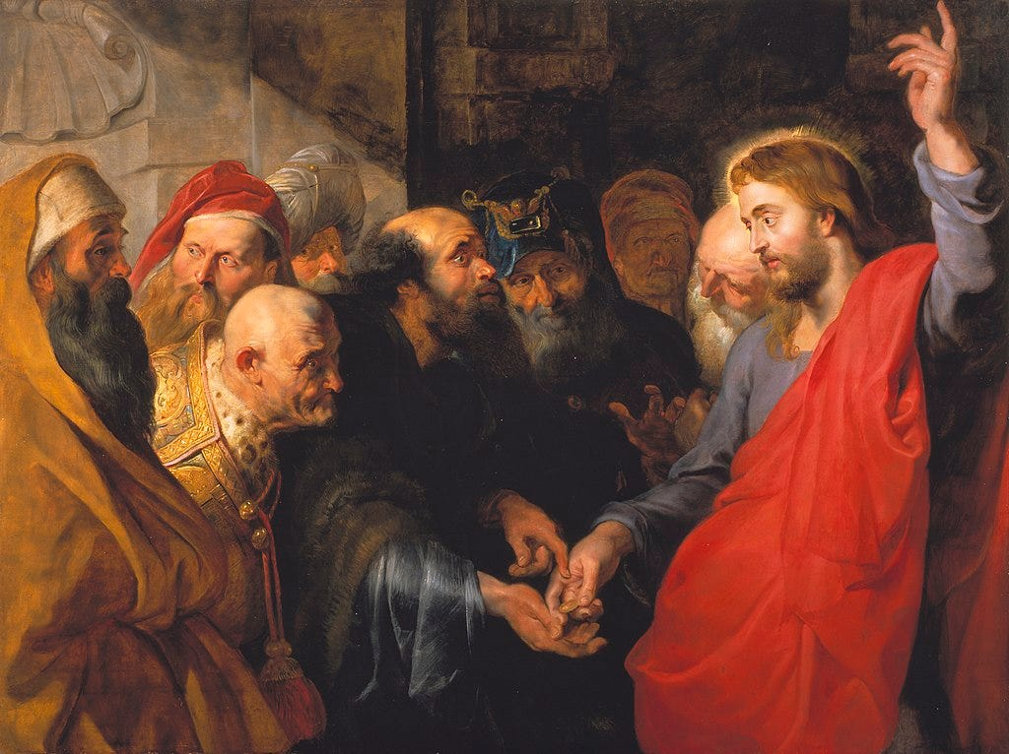

Slide 19
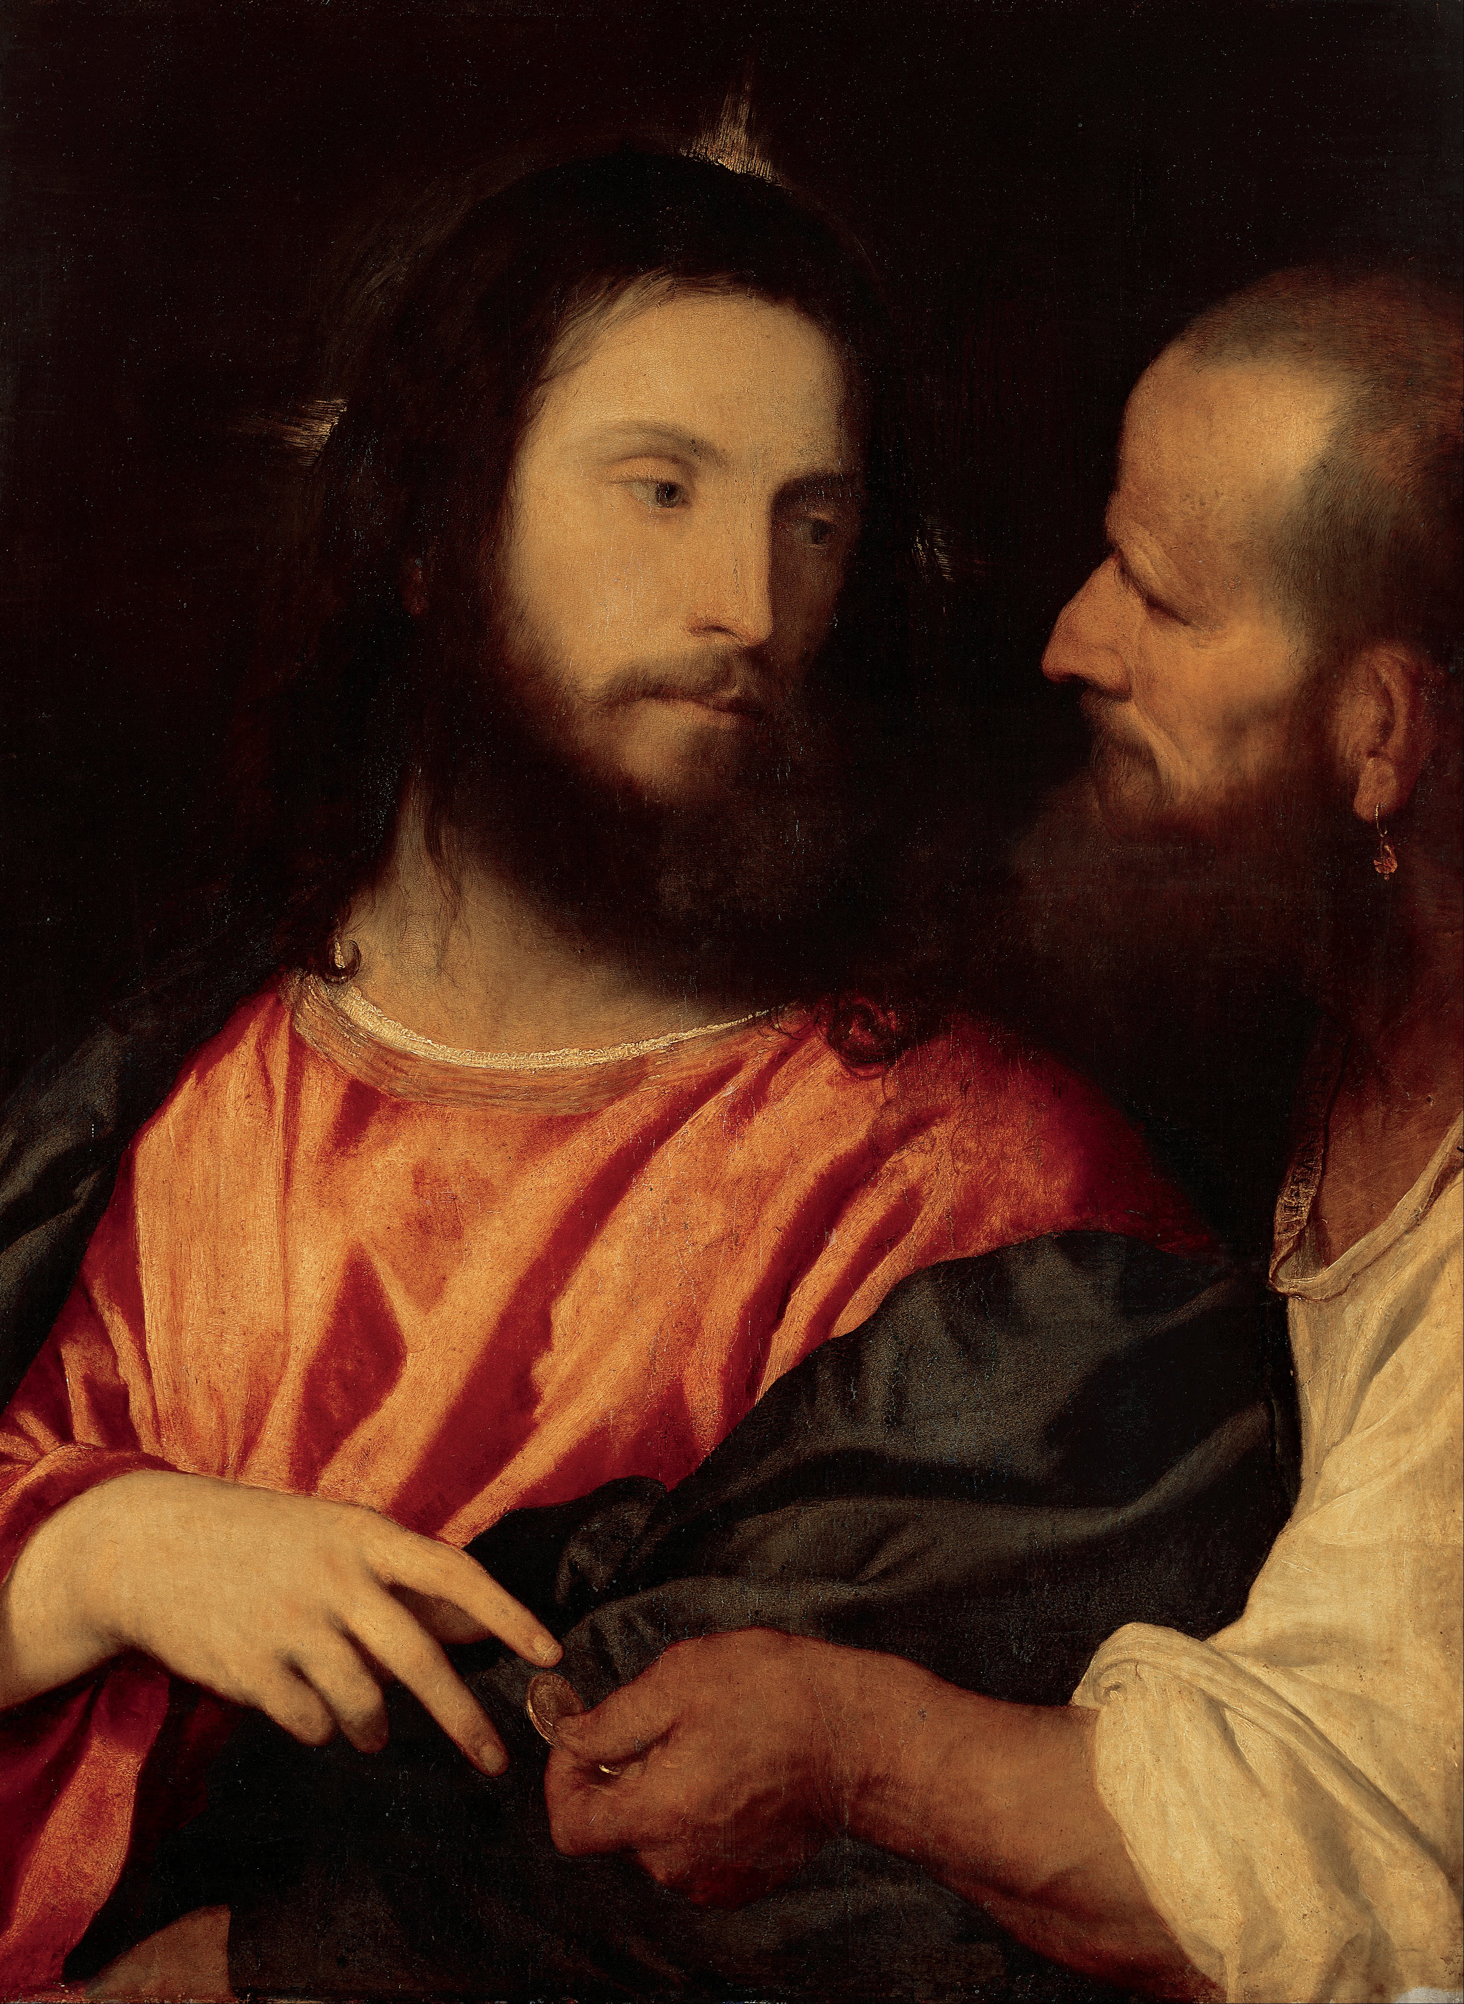
“Why are you testing me, you hypocrites?”
- Matthew 22:18

Slide 20
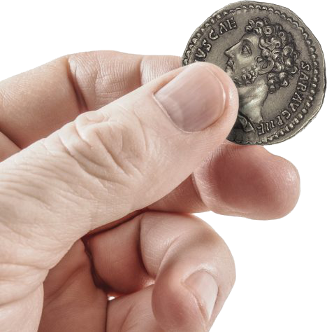
#1. Use Questions to Make a Point
“Whose image is on the coin?”
“Then give to Caesar what is Caesar’s, and to God what is God’s.”

Slide 21
#1. Use Questions to Make a Point
If something bears an image, then:
1. It rightfully belongs to them.
2. We live in their kingdom.

Slide 22

#1. Use Questions to Make a Point
If something bears an image, then:
“Whose image is on us?”
1. We rightfully belong to God.
2. We live in His kingdom.

Slide 23
#1. Use Questions to Make a Point
“Whose image is on us?”
“Then give to Caesar what is Caesar’s and to God what is God’s.”

Slide 24
Learn How to Ask Questions:
You don’t need to know all the right answers, just know how to ASK the right QUESTIONS.

Slide 25
Tactical Tools
#2. REWORD THE POSITION TO EXPOSE THE PROBLEM

Slide 26

#2. Reword the Position to Expose the Problem
1. “Remove the fluff” from the claim.

Slide 27
#2. Reword the Position to Expose the Problem
1. “Remove the fluff” from the claim.
2. Reword the principle and apply it to a counter-example.

Slide 28
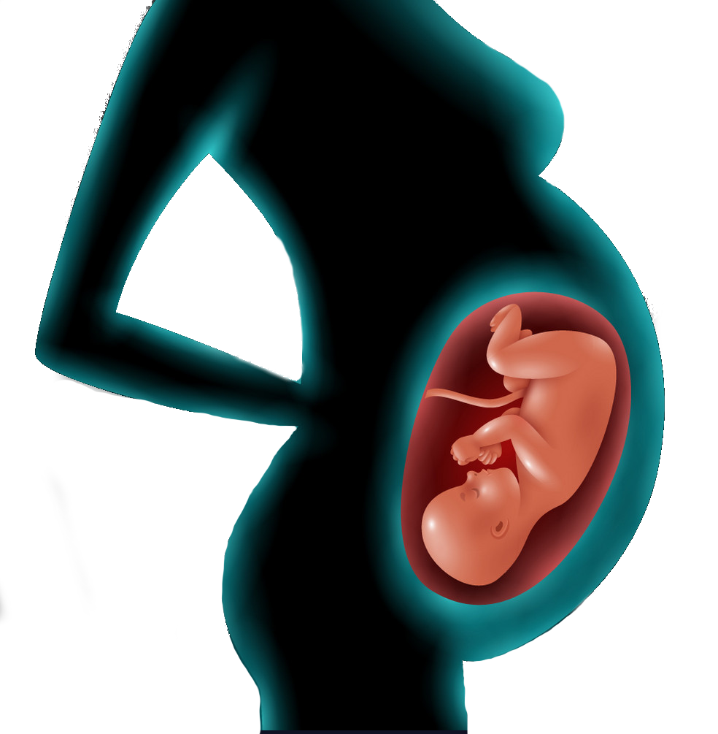

The Principle
“No, because it harms innocent people, and that’s not right.”
Counter-example

Slide 29
Tactical Tools
#3. EMPHASIZE REBUTTALS

Slide 30

#3. Emphasize Rebuttals
Refutations vs Rebuttals
Claim: It will rain today because I’m wearing brown shoes.

Slide 31
#3. Emphasize Rebuttals
Refutations vs Rebuttals
Refutation = proving their conclusion is false.
(attack conclusion)
Rebuttal = showing their conclusion hasn’t been proven true. (attack justification)
Refutation = proving their conclusion is false.
(attack conclusion)
Rebuttal = showing their conclusion hasn’t been proven true.

Slide 32
#3. Emphasize Rebuttals
Refutation = attack conclusion
Claim: It will rain today because I’m wearing brown shoes.
Rebuttal = attack justification

Slide 33
#3. Emphasize Rebuttals
Refutation = attack conclusion
Refutation:
Refutation: No, it will not rain today because the atmospheric pressure, temperature, weather, and moisture in the air are insufficient to provide rain.
Claim: It will rain today because I’m wearing brown shoes.
  This requires more KNOWLEDGE.

Slide 34
#3. Emphasize Rebuttals
Rebuttal: No, not necessarily, because you wore brown shoes yesterday, and it didn’t rain.
Rebuttal:
Claim: It will rain today because I’m wearing brown shoes.
This only requires knowledge of their
JUSTIFICATION.
Rebuttal = attack justification

Slide 35
Which is easier?
The REBUTTAL
Which takes more work?
The REFUTATION

Slide 36
#3. Emphasize Rebuttals
Claim: God doesn’t exist because evolution is true.
Rebuttal: But if God exists, couldn’t He use evolution to bring about our species?

Slide 37
Tactical Tools
#4. DISCERNMENT: NEITHER REFUTATION NOR REBUTTAL

Slide 38
#4. Discernment: Neither Refutation Nor Rebuttal
A person hasn’t given an actual argument or objection (neither a refutation nor rebuttal is needed).
They’re merely making a declarative statement, asserting a claim without justification, or passionately expressing their emotions.

Slide 39

Bonus Pastoral Response:
Yup, the church is full of them, but I’m sure we have room for one more!
Claim: Christians are hypocrites!
Go on…
Sure, some are. But how does this prove there’s no God?
Sure, and some atheists are hypocrites too. So what?

Slide 40
#4. Discernment: Neither Refutation Nor Rebuttal
My “biggest obstacle” to belief in God is the existence of evil.
- Explain.
- Why?
-Yes.
- Why not?
- Go on…

Slide 41
Tactical Tools
#5. IDENTIFY LOGICAL FALLACIES

Slide 42
#5. Identify Logical Fallacies
Logical Fallacy: an error in logic or reason
?
Do not answer a fool according to his folly, or you yourself will be just like him. Answer a fool according to his folly, or he will be wise in his own eyes.
- Proverbs 26:4-5

Slide 43
2 RULES for Conversing with Nonbelievers
Do not answer [nor pretend to agree with the frivolous comments of] a [closed-minded] fool according to his folly, otherwise you, even you, will be like him. Answer [and correct the erroneous concepts of] a fool according to his folly, otherwise he will be wise in his own eyes [if he thinks you agree with him].
- Proverbs 26:4-5

Slide 44
2 RULES for Conversing with Nonbelievers
Rule #1: Do not engage in fallacious reasoning
(Don’t be like him).

Slide 45
2 RULES for Conversing with Nonbelievers
Do not answer [nor pretend to agree with the frivolous comments of] a [closed-minded] fool according to his folly, otherwise you, even you, will be like him. Answer [and correct the erroneous concepts of] a fool according to his folly, otherwise he will be wise in his own eyes [if he thinks you agree with him].
- Proverbs 26:4-5

Slide 46
2 RULES for Conversing with Nonbelievers
Rule #1: Do not engage in fallacious reasoning
(Don’t be like him).
Rule #2: Point out and correct their fallacious reasoning
Rule #2: Point out and correct their fallacious reasoning (Don’t let him think he’s right).

Slide 47
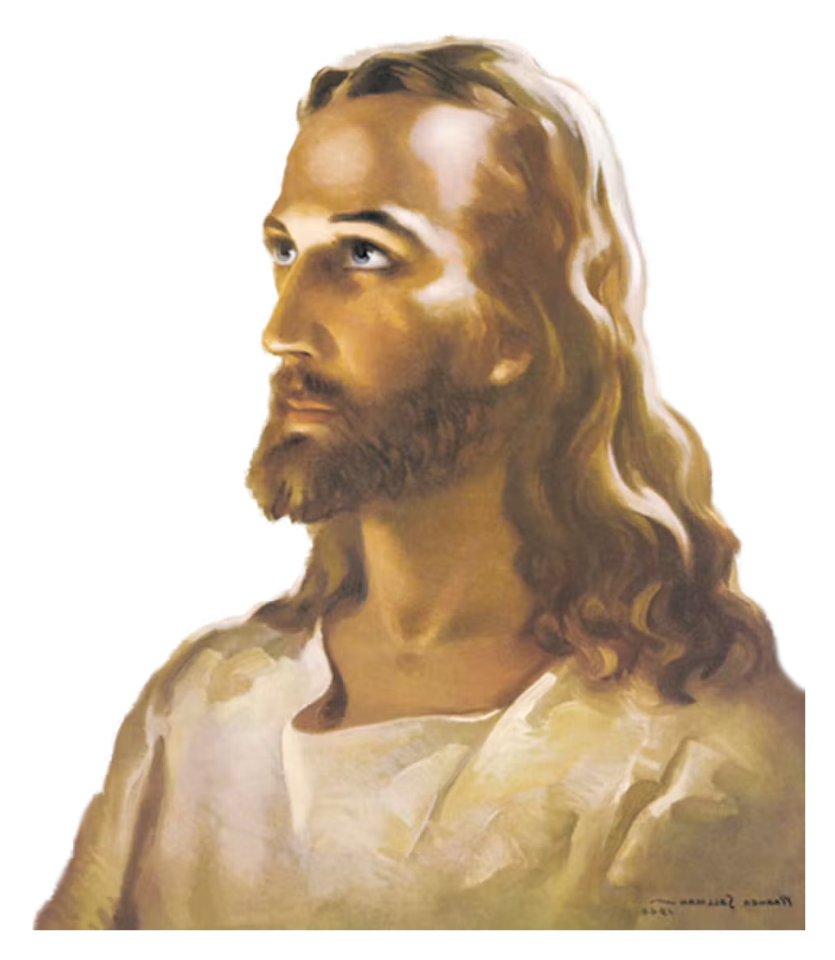
#5. Identify Logical Fallacies
Examples:
Matthew 22:23-33
• Begging the Question/
Circular Reasoning
• False Dichotomy
?
• False Presupposition
• Reductio Ad Absurdum (Reduces to Absurdity)

Slide 48
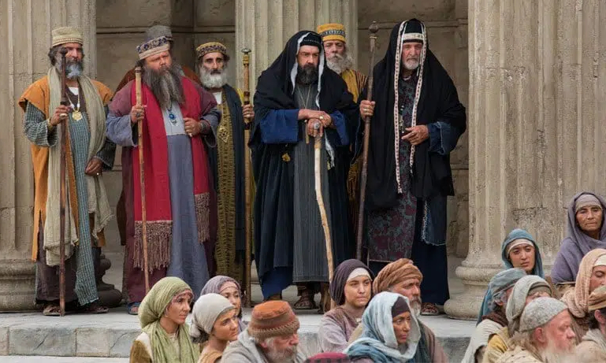
#5. Identify Logical Fallacies
Matthew 22:23-33
X Resurrection
X Afterlife
X Intermediate State
X Angels/Spirits

Slide 49

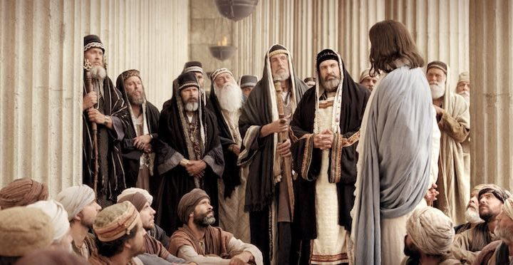


#5. Identify Logical Fallacies
Matthew 22:23-33

Slide 50
#5. Identify Logical Fallacies
Examples:
Matthew 22:23-33
• Begging the Question/
Circular Reasoning
• False Dichotomy
• False Presupposition
• Reductio Ad Absurdum (Reduces to Absurdity)

Slide 51
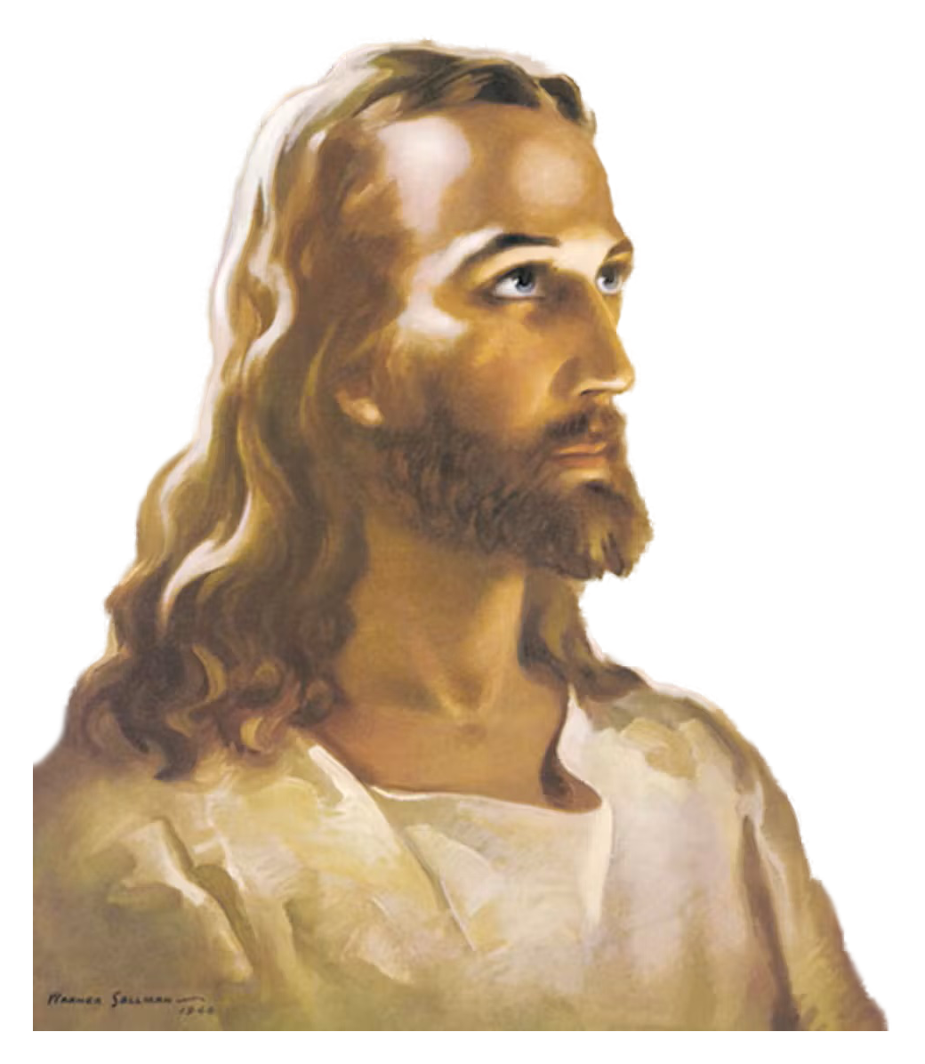
#5. Identify Logical Fallacies
Examples:
THE REBUTTAL (vs 29-30)
• Begging the Question/
Circular Reasoning
• False Dichotomy
“You are wrong because you don’t know the scriptures…”
• False Presupposition
• Reductio Ad Absurdum (Reduces to Absurdity)

Slide 52
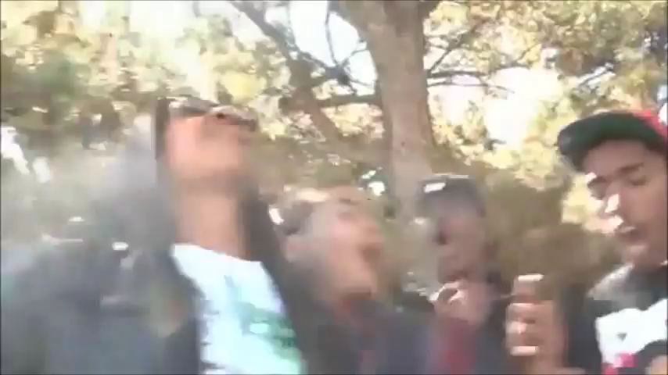

Slide 53

#5. Identify Logical Fallacies
Examples:
THE REBUTTAL (vs 29-30)
• Begging the Question/
Circular Reasoning
• False Dichotomy
• False Presupposition
X
• Reductio Ad Absurdum (Reduces to Absurdity)

Slide 54
#5. Identify Logical Fallacies
THE REFUTATION (vs 31-32)
“Have you not read…?”

Slide 55
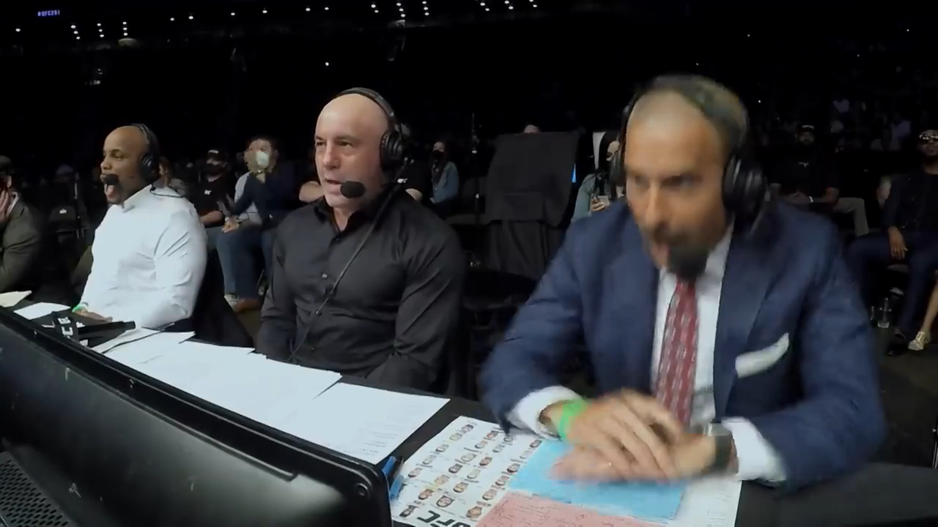

Slide 56
#5. Identify Logical Fallacies
THE REFUTATION (vs 31-32)
“ ‘I am the God of Abraham, Isaac, and Jacob’…

Slide 57
#5. Identify Logical Fallacies
Keep the Main Thing THE Main Thing
THE REFUTATION (vs 31-32)
“ ‘I am the God of Abraham, Isaac, and Jacob’…

Slide 58
2 Biblical Principles (Col 4:5-6)
Make the most use of the time.
(“Theological Triage”)
2. Know HOW to answer
(instead of “WHAT” to answer)
“ ‘I am the God of Abraham, Isaac, and Jacob’…
“ ‘I am the God of Abraham, Isaac, and Jacob’…He is not the God of the dead, but of the living.”

Slide 59
#5. Identify Logical Fallacies
THE REFUTATION (vs 31-32)
“ ‘I am the God of Abraham, Isaac, and Jacob’…
“ ‘I am the God of Abraham, Isaac, and Jacob’…He is not the God of the dead, but of the living.”

Slide 60
#5. Identify Logical Fallacies
THE REFUTATION (vs 31-32)
“ ‘I am the God of Abraham, Isaac, and Jacob’…
“ ‘I am the God of Abraham, Isaac, and Jacob’…He is not the God of the dead, but of the living.”

Slide 61
#5. Identify Logical Fallacies
“ When the crowds heard this, they were astonished at his teaching… Jesus had silenced the Sadducees.”
(vs 33-34)
THE REFUTATION (vs 31-32)
“ ‘I am the God of Abraham, Isaac, and Jacob’…
“ ‘I am the God of Abraham, Isaac, and Jacob’…He is not the God of the dead, but of the living.”

Slide 62
#5. Identify Logical Fallacies
“…and from that day on no one dared to ask him any more questions.”
(vs 46)
THE REFUTATION (vs 31-32)
“ ‘I am the God of Abraham, Isaac, and Jacob’…
“ ‘I am the God of Abraham, Isaac, and Jacob’…He is not the God of the dead, but of the living.”

Slide 63
#5. Identify Logical Fallacies
THE REFUTATION (vs 31-32)
“ ‘I am the God of Abraham, Isaac, and Jacob’…
“ ‘I am the God of Abraham, Isaac, and Jacob’…He is not the God of the dead, but of the living.”

Slide 65


