Slide 1


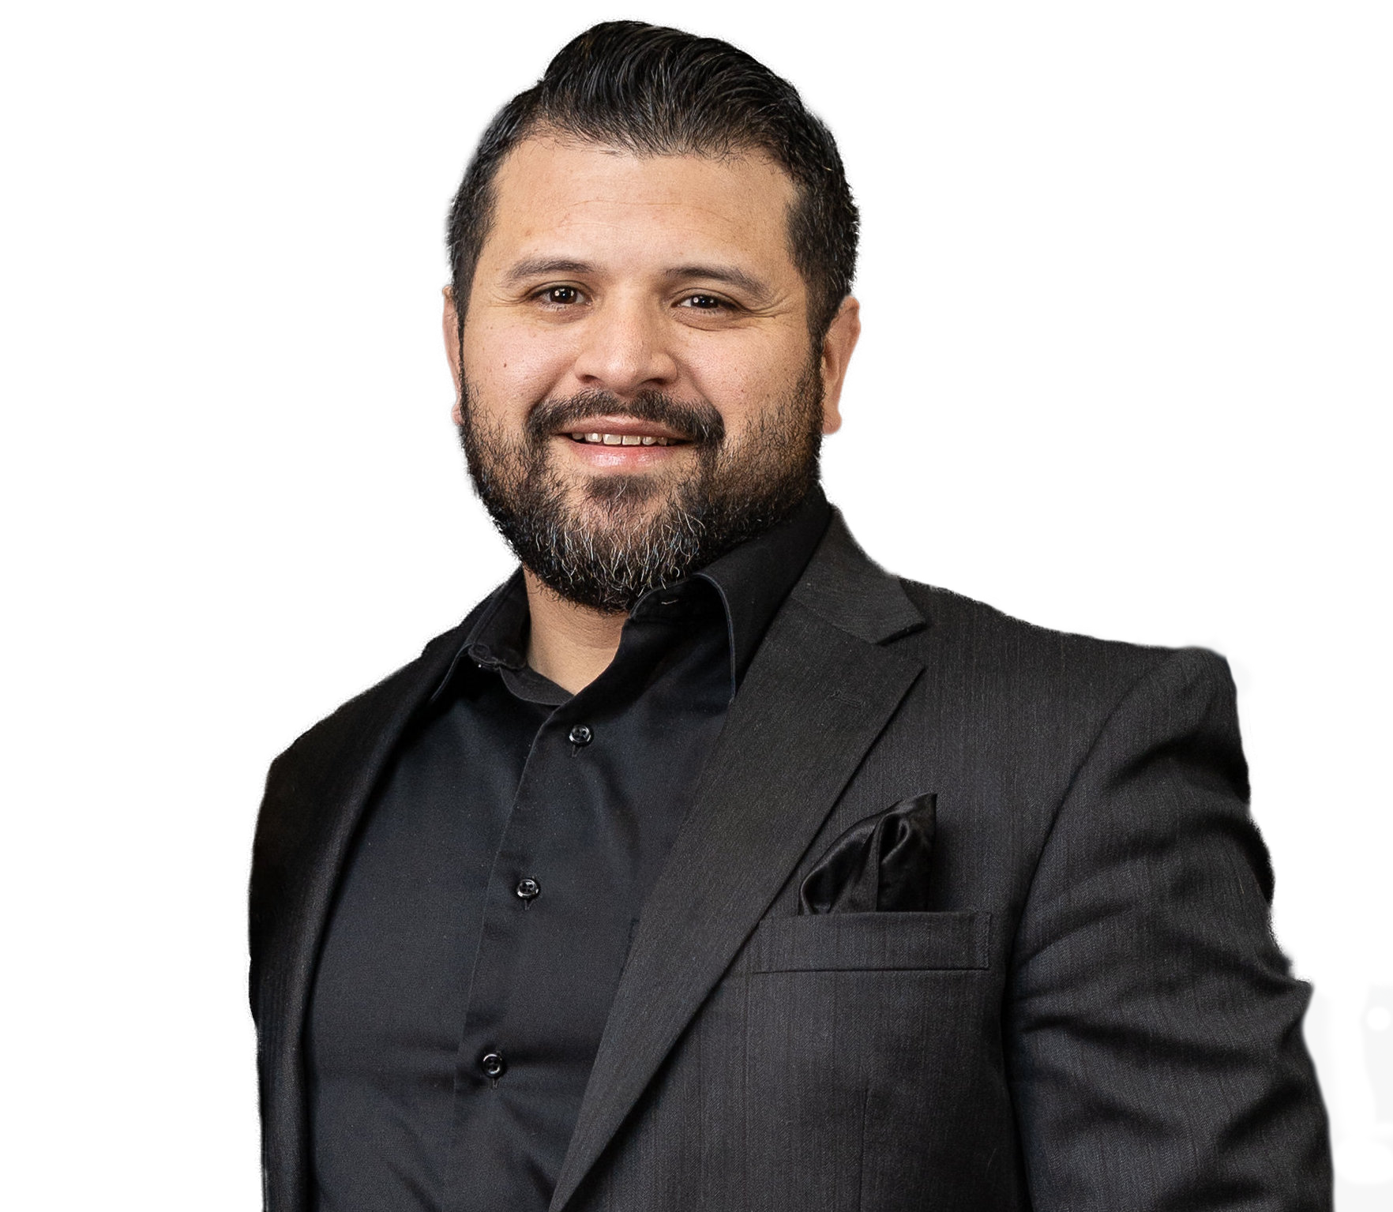

DEALING WITH DOUBT
EhmApologetics.org

Slide 2

But if you can do anything, take pity on us and help us.” Jesus said to him, “[You say to Me,] ‘If You can?’ All things are possible for the one who believes and trusts [in Me]!” Immediately the father of the boy cried out [with a desperate, piercing cry], saying, “I do believe; help [me overcome] my unbelief.”
- Mark 9:22-24
But if you can do anything, take pity on us and help us.” Jesus said to him, “[You say to Me,] ‘If You can?’ All things are possible for the one who believes and trusts [in Me]!” Immediately the father of the boy cried out [with a desperate, piercing cry], saying, “I do believe; help [me overcome] my unbelief.”
- Mark 9:22-24

Slide 3


SIT
DEALING
WITH DOUBT
Ephesians
2:6-9
IN JESUS

Slide 4
FAITH
faith
“And without faith it is impossible to please God…”
impossible
- Hebrews 11:6

Slide 5
What is FAITH?
“Pistis” = Trust or Confidence
Faith is based on/grounded in knowledge
“TRUST IN” requires a “KNOW THAT”

Slide 6
What is FAITH?
The greater my knowledge of the thing in question, the greater my trust or confidence (i.e., faith) I have in it.

Slide 7
How do we grow in FAITH?
By growing in our knowledge of the thing we are seeking to trust.
The more I grow in my knowledge of God, the more confidence (i.e., faith) I have in who He is.

Slide 8
Hosea 4:6
“My people are destroyed from lack of KNOWLEDGE.”
“My people are destroyed from lack of

Slide 9
HOW WE DEAL WITH DOUBT

Slide 10
HOW DO WE FORM BELIEFS?
“ Doxastic Voluntarism”
*THIS IS IMPOSSIBLE*
Doxastic = “belief”
Voluntarism = the “will”
Direct Doxastic Voluntarism = forcing yourself to believe something simply by sheer willpower.

Slide 11
HOW DO WE FORM BELIEFS?
Indirect Doxastic Voluntarism
= I can move in degrees of my beliefs by exposing myself to reliable information.
*(puts me in a position to change a belief)*

Slide 12
HOW WE HELP OTHERS DEAL WITH DOUBT
Jude 1:22 “Be merciful to those who doubt.”
John 20:24-29 “Doubting Thomas” (v. 19-20)

Slide 13
HOW WE HELP OTHERS DEAL WITH DOUBT
Intellectual doubt:
can be written down.
Emotional doubt:
cannot be written down.
Matthew 11:2-5
John 10:25,38
John 14:11

Slide 14
NOT EVERY CHRISTIAN DOUBTS.
ONLY THE ONES WHO TAKE THEIR FAITH SERIOUSLY, DO.

Slide 15
Possible Reasons/Causes of Doubt:
Main reason: unbiblical expectations (theologically false assumptions)
Praying for things God can’t do.
  Change person X’s mind.
  Make someone love you etc.

Slide 16
Possible Reasons/Causes of Doubt:
Main reason: unbiblical expectations (theologically false assumptions)
Assume God’s purpose is to make you healthy and happy.
You think God has to work through YOUR expectations and assumptions (John 5:2-9)

Slide 17
Recognitions for Doubt:
Recognize that doubting is normal.
Recognize that good evidence exists supporting the truth of Christianity.
Recognize that absolute certainty is an unreasonable expectation.
Recognize that faith is more than a feeling or being without doubt. It’s a commitment.

