Slide 1


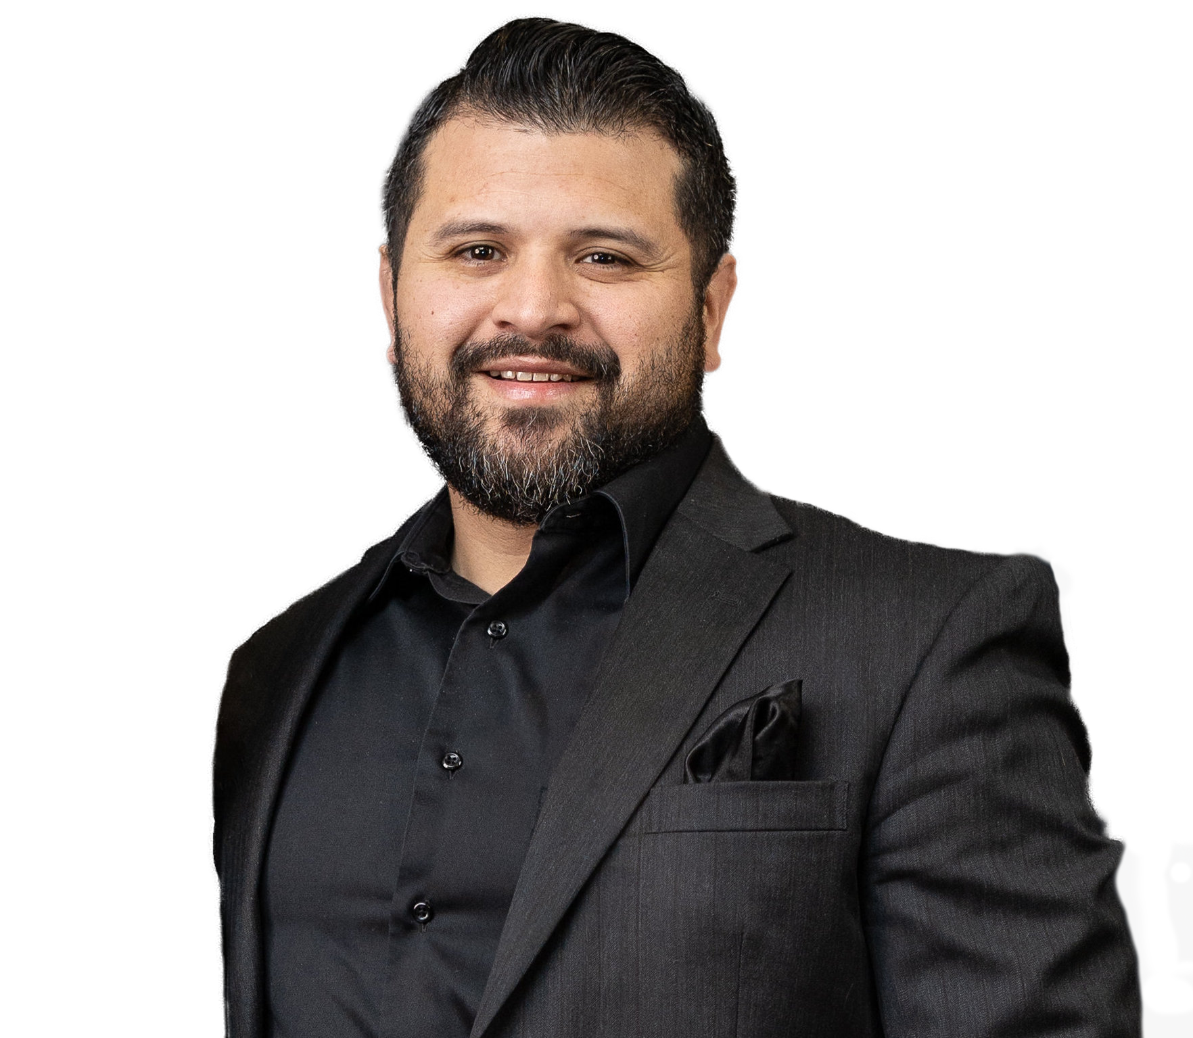

EhmApologetics.org

Slide 2
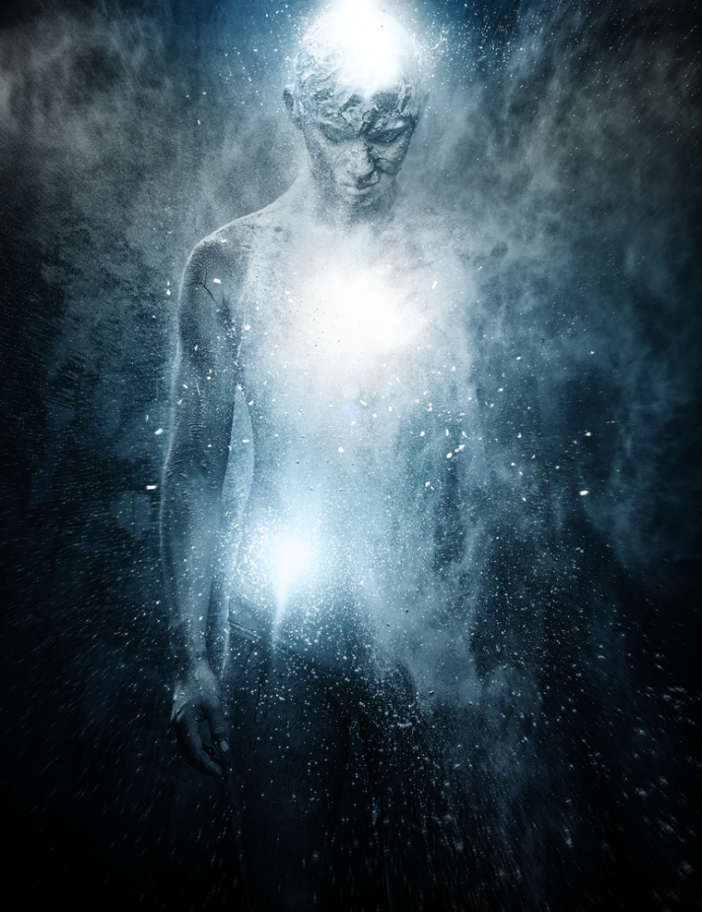
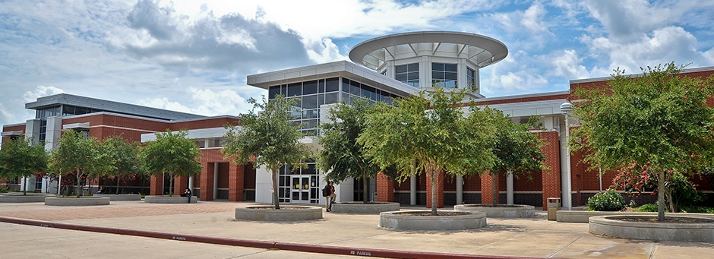
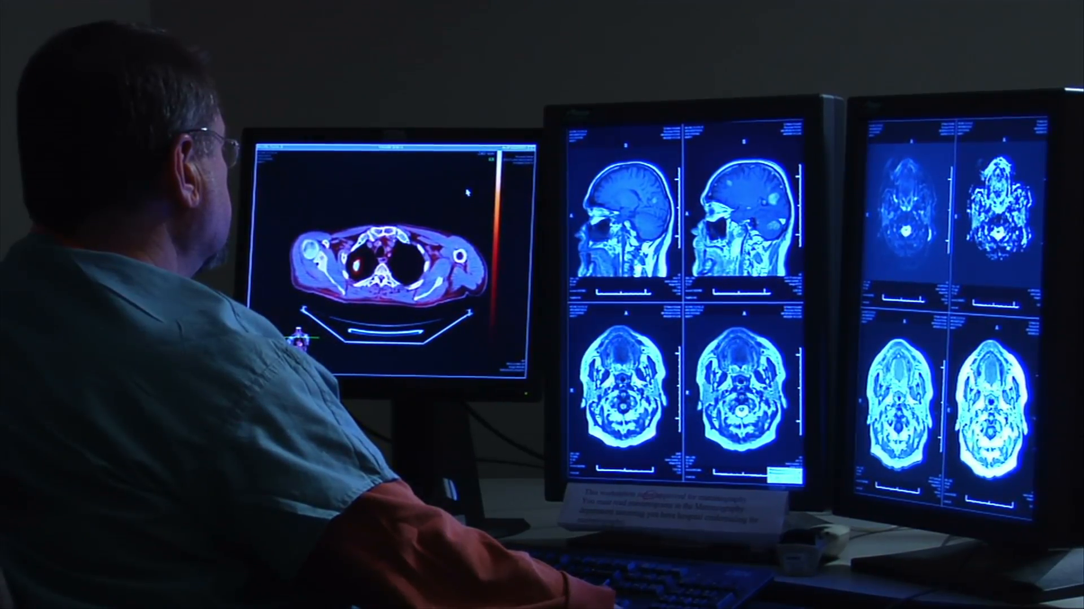
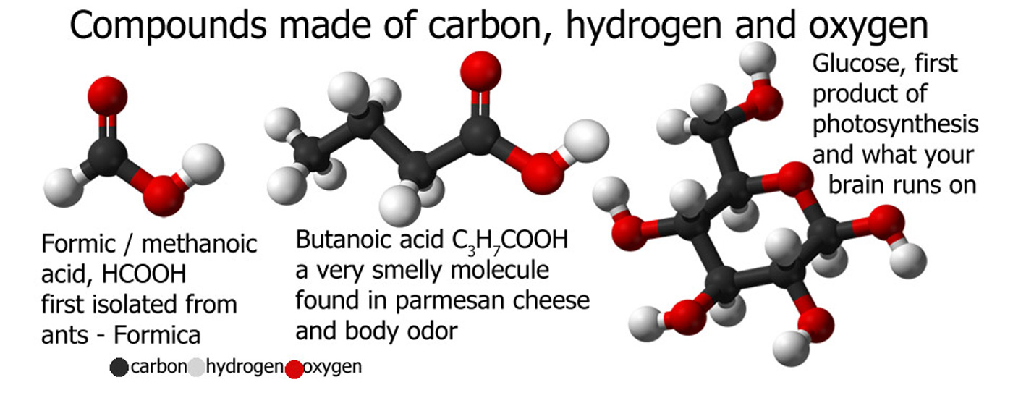
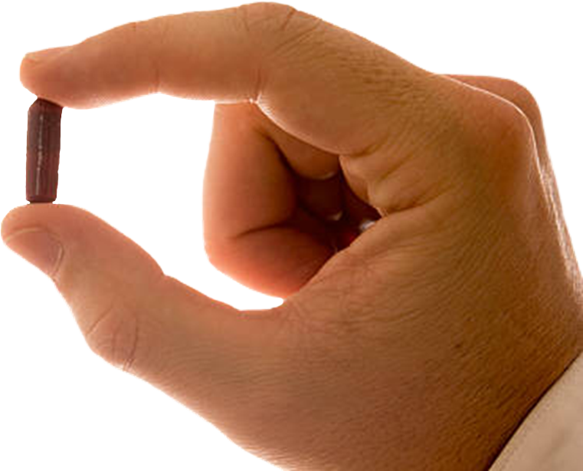
?
?

Slide 3
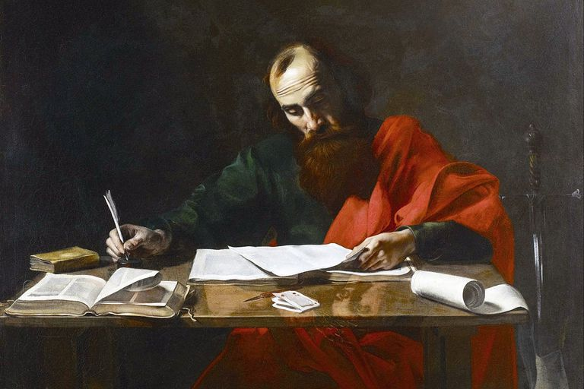
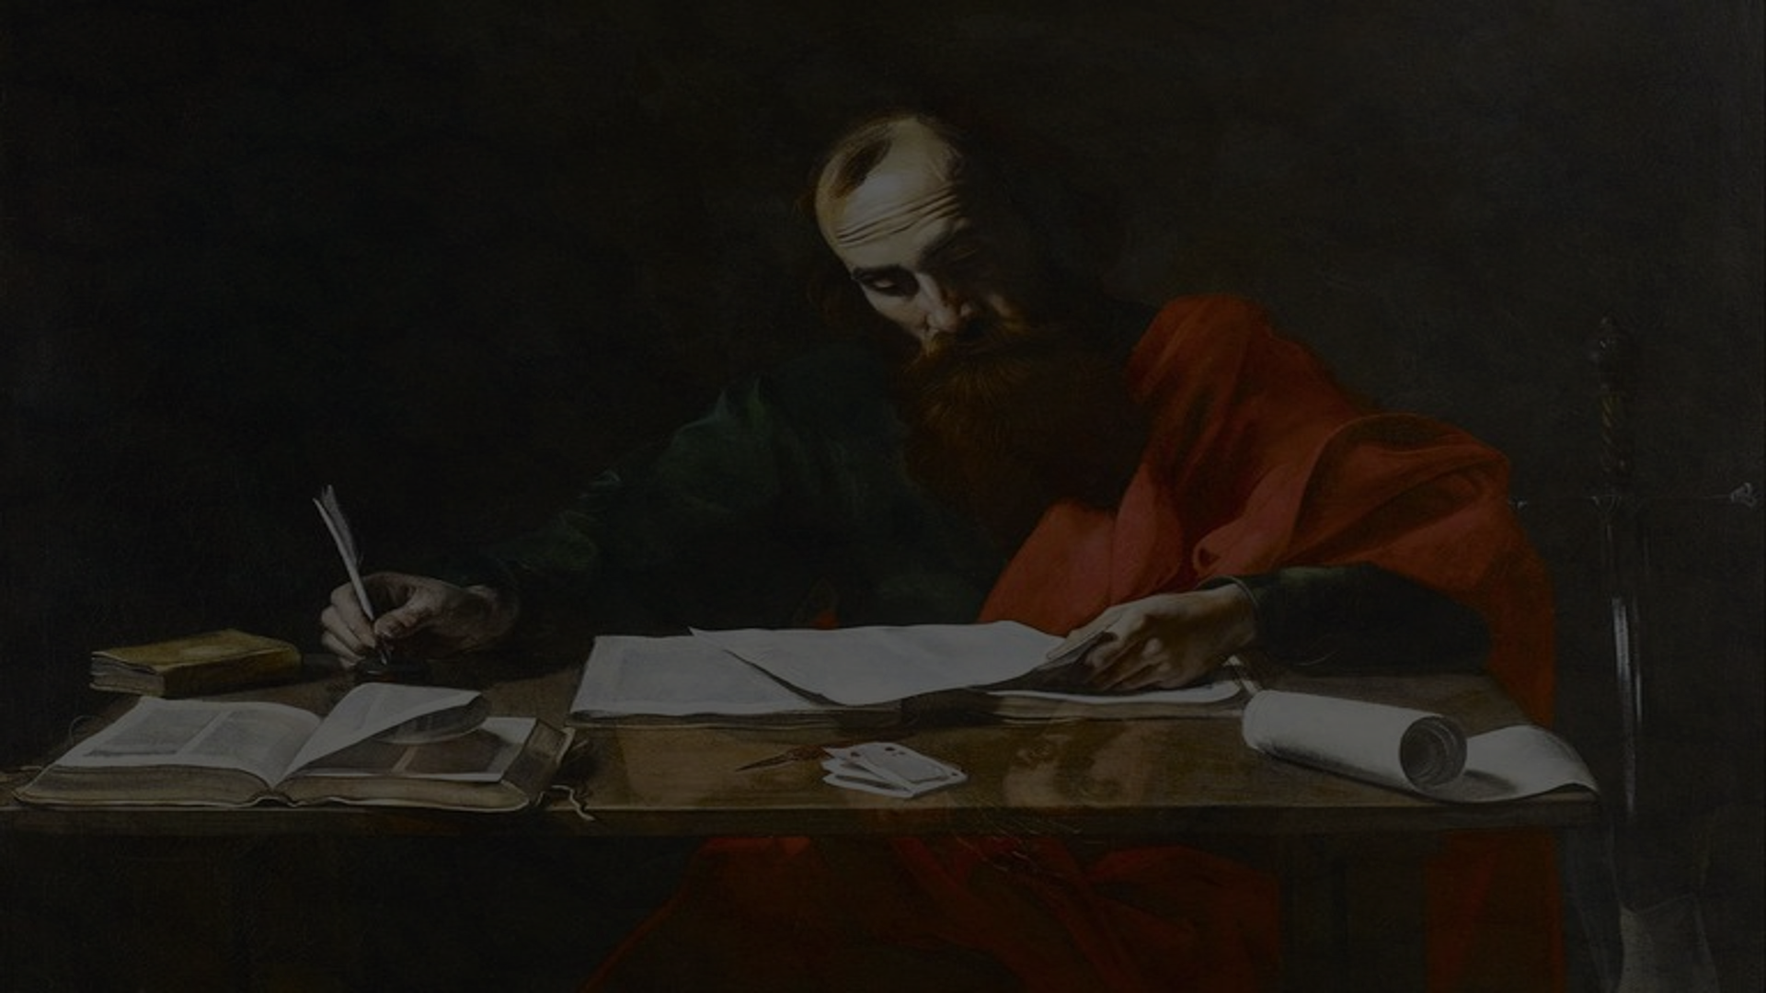
“And if Christ has not been raised, then our preaching is vain [useless, amounting to nothing], and your faith is also vain [imaginary, unfounded, devoid of value and benefit—not based on truth]… For if the dead are not raised, then Christ has not been raised, either; and if Christ has not been raised, your faith is worthless and powerless [mere delusion]…If we who are [abiding] in Christ have hoped only in this life [and this is all there is], then we are of all people most miserable and to be pitied.” 1 Cor 15:14-19
“And if Christ has not been raised, then our preaching is vain [useless, amounting to nothing], and your faith is also vain [imaginary, unfounded, devoid of value and benefit—not based on truth]… For if the dead are not raised, then Christ has not been raised, either; and if Christ has not been raised, your faith is worthless and powerless [mere delusion]…If we who are [abiding] in Christ have hoped only in this life [and this is all there is], then we are of all people most miserable and to be pitied.” 1 Cor 15:14-19
“And if Christ has not been raised, then our preaching is vain [useless, amounting to nothing], and your faith is also vain [imaginary, unfounded, devoid of value and benefit—not based on truth]… For if the dead are not raised, then Christ has not been raised, either; and if Christ has not been raised, your faith is worthless and powerless [mere delusion]…If we who are [abiding] in Christ have hoped only in this life [and this is all there is], then we are of all people most miserable and to be pitied.” 1 Cor 15:14-19
“And if Christ has not been raised, then our preaching is vain [useless, amounting to nothing], and your faith is also vain [imaginary, unfounded, devoid of value and benefit—not based on truth]… For if the dead are not raised, then Christ has not been raised, either; and if Christ has not been raised, your faith is worthless and powerless [mere delusion]…If we who are [abiding] in Christ have hoped only in this life [and this is all there is], then we are of all people most miserable and to be pitied.” 1 Cor 15:14-19
“And if Christ has not been raised, then our preaching is vain [useless, amounting to nothing], and your faith is also vain [imaginary, unfounded, devoid of value and benefit—not based on truth]… For if the dead are not raised, then Christ has not been raised, either; and if Christ has not been raised, your faith is worthless and powerless [mere delusion]…If we who are [abiding] in Christ have hoped only in this life [and this is all there is], then we are of all people most miserable and to be pitied.” 1 Cor 15:14-19
“And if Christ has not been raised, then our preaching is vain [useless, amounting to nothing], and your faith is also vain [imaginary, unfounded, devoid of value and benefit—not based on truth]… For if the dead are not raised, then Christ has not been raised, either; and if Christ has not been raised, your faith is worthless and powerless [mere delusion]…If we who are [abiding] in Christ have hoped only in this life [and this is all there is], then we are of all people most miserable and to be pitied.” 1 Cor 15:14-19
“And if Christ has not been raised, then our preaching is vain [useless, amounting to nothing], and your faith is also vain [imaginary, unfounded, devoid of value and benefit—not based on truth]… For if the dead are not raised, then Christ has not been raised, either; and if Christ has not been raised, your faith is worthless and powerless [mere delusion]…If we who are [abiding] in Christ have hoped only in this life [and this is all there is], then we are of all people most miserable and to be pitied.” 1 Cor 15:14-19
“And if Christ has not been raised, then our preaching is vain [useless, amounting to nothing], and your faith is also vain [imaginary, unfounded, devoid of value and benefit—not based on truth]… For if the dead are not raised, then Christ has not been raised, either; and if Christ has not been raised, your faith is worthless and powerless [mere delusion]…If we who are [abiding] in Christ have hoped only in this life [and this is all there is], then we are of all people most miserable and to be pitied.” 1 Cor 15:14-19
“And if Christ has not been raised, then our preaching is vain [useless, amounting to nothing], and your faith is also vain [imaginary, unfounded, devoid of value and benefit—not based on truth]… For if the dead are not raised, then Christ has not been raised, either; and if Christ has not been raised, your faith is worthless and powerless [mere delusion]…If we who are [abiding] in Christ have hoped only in this life [and this is all there is], then we are of all people most miserable and to be pitied.” 1 Cor 15:14-19
“And if Christ has not been raised, then our preaching is vain [useless, amounting to nothing], and your faith is also vain [imaginary, unfounded, devoid of value and benefit—not based on truth]… For if the dead are not raised, then Christ has not been raised, either; and if Christ has not been raised, your faith is worthless and powerless [mere delusion]…If we who are [abiding] in Christ have hoped only in this life [and this is all there is], then we are of all people most miserable and to be pitied.” 1 Cor 15:14-19
“And if Christ has not been raised, then our preaching is vain [useless, amounting to nothing], and your faith is also vain [imaginary, unfounded, devoid of value and benefit—not based on truth]… For if the dead are not raised, then Christ has not been raised, either; and if Christ has not been raised, your faith is worthless and powerless [mere delusion]…If we who are [abiding] in Christ have hoped only in this life [and this is all there is], then we are of all people most miserable and to be pitied.” 1 Cor 15:14-19
“And if Christ has not been raised, then our preaching is vain [useless, amounting to nothing], and your faith is also vain [imaginary, unfounded, devoid of value and benefit—not based on truth]… For if the dead are not raised, then Christ has not been raised, either; and if Christ has not been raised, your faith is worthless and powerless [mere delusion]…
“And if Christ has not been raised, then our preaching is vain [useless, amounting to nothing], and your faith is also vain [imaginary, unfounded, devoid of value and benefit—not based on truth]…

Slide 4
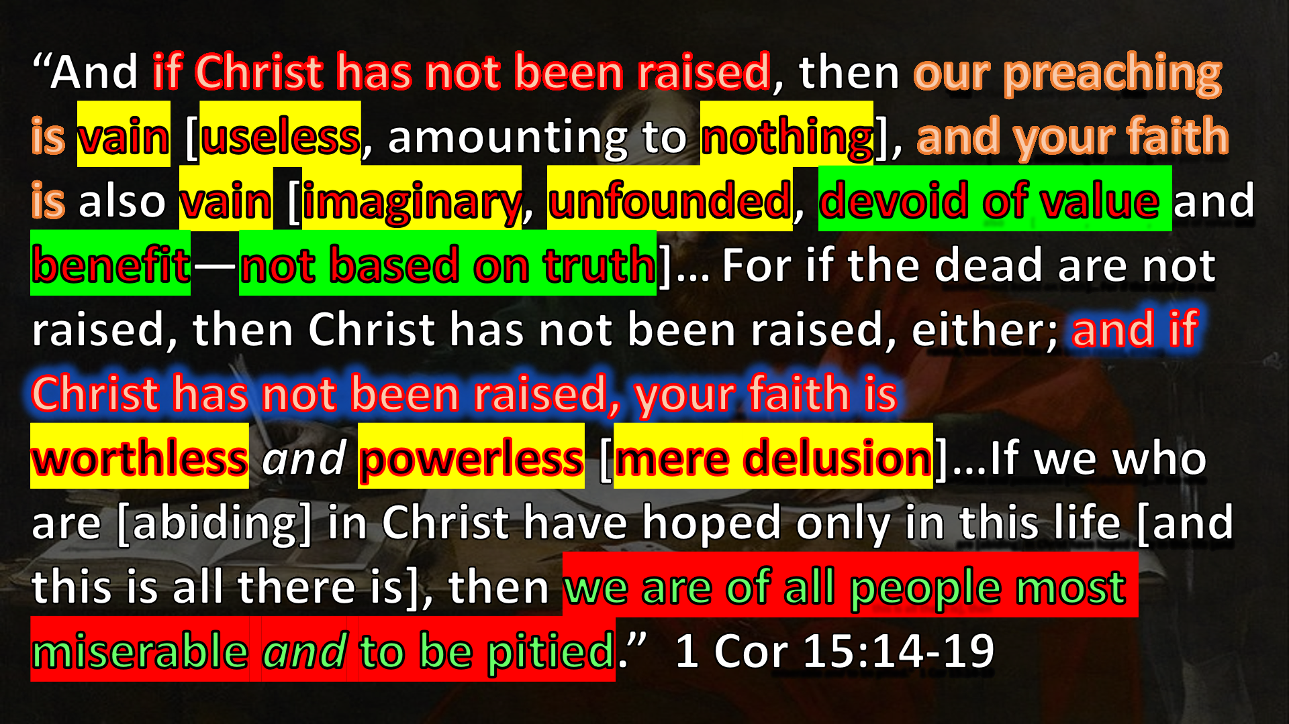
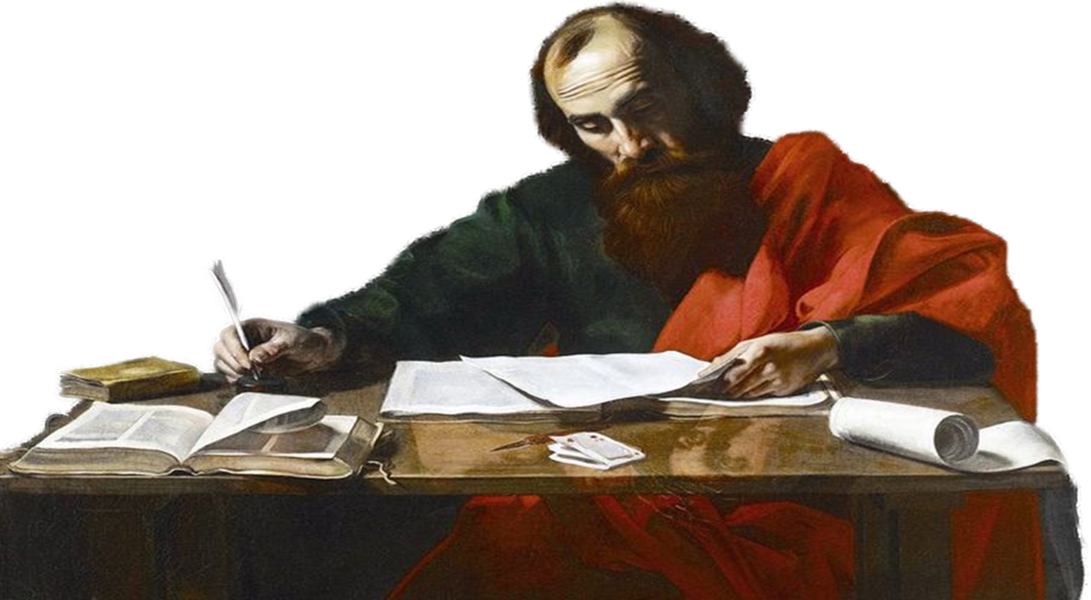
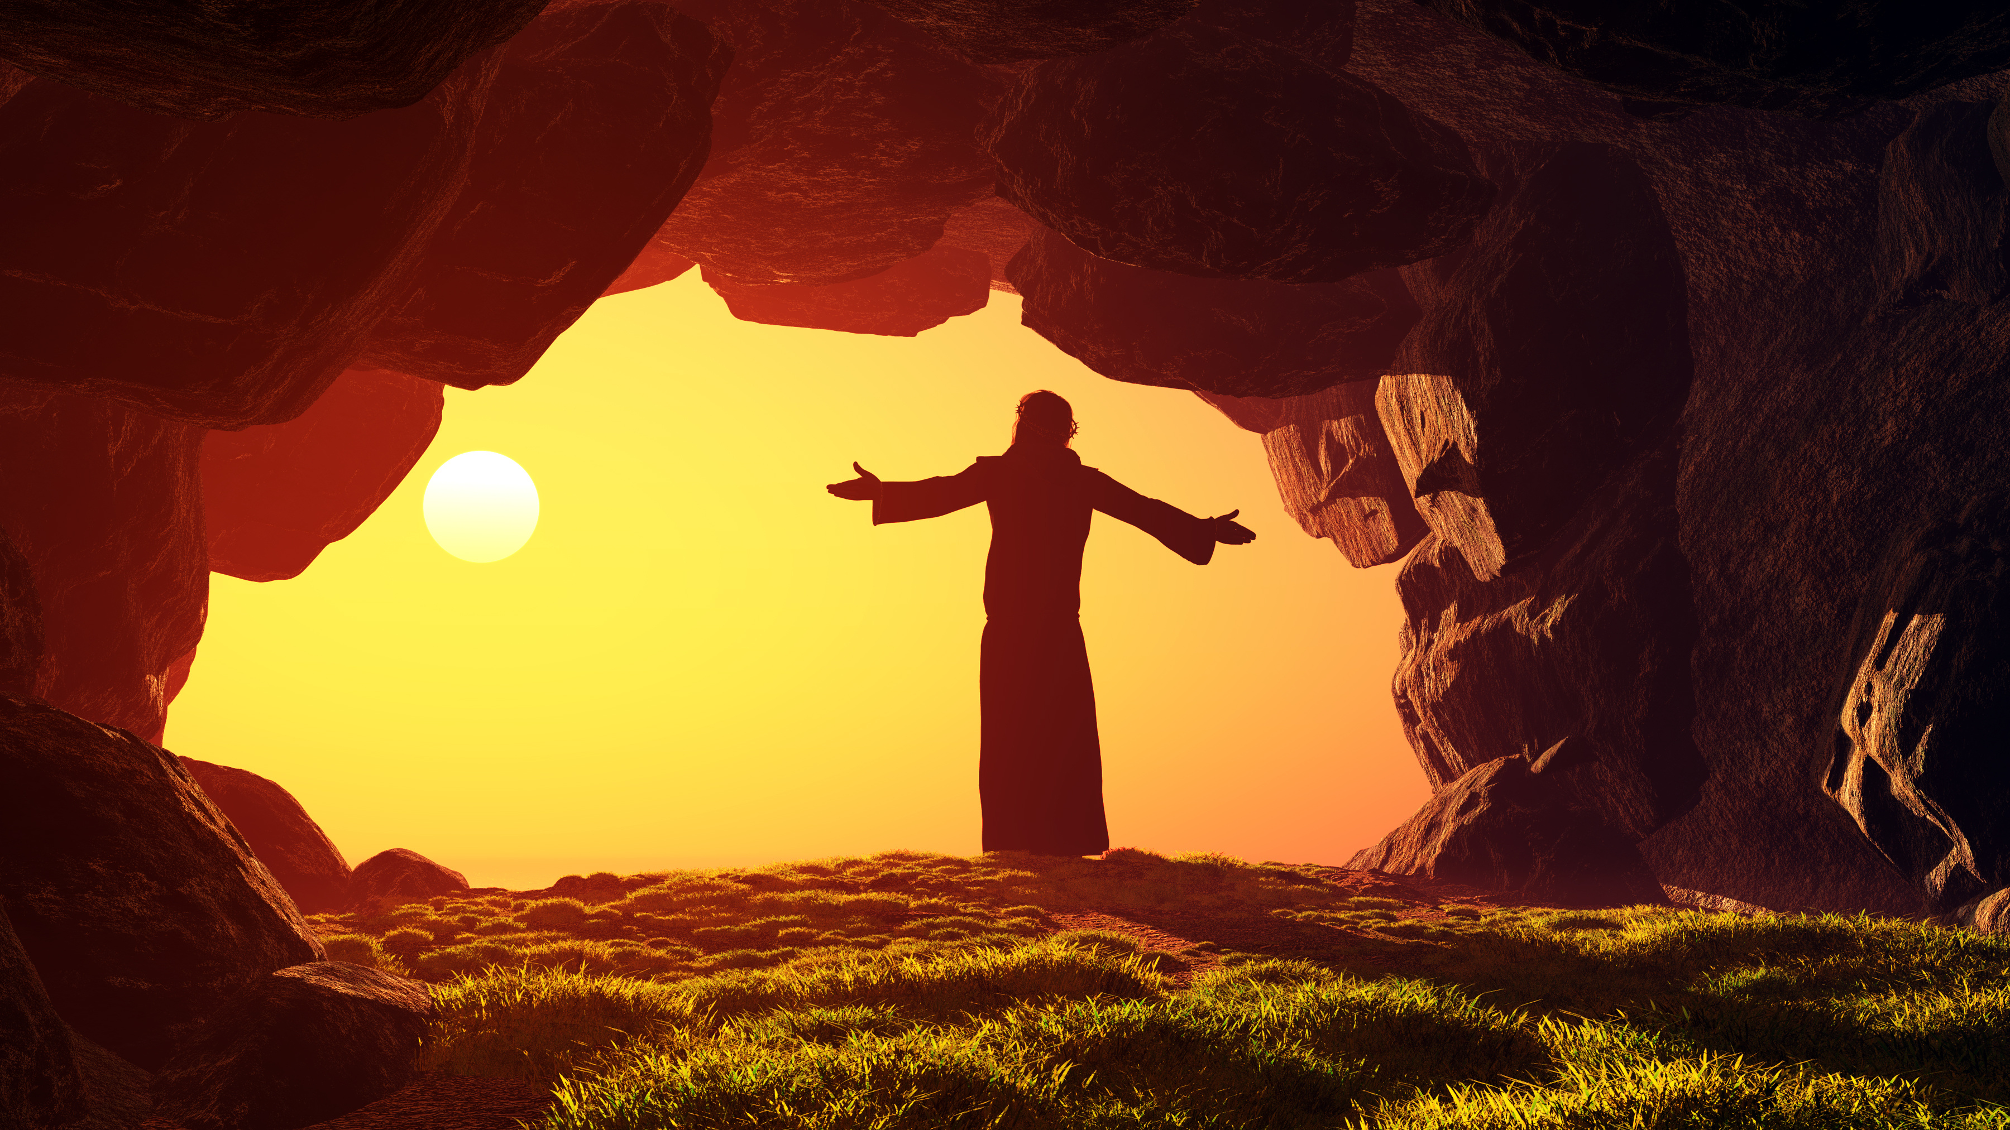
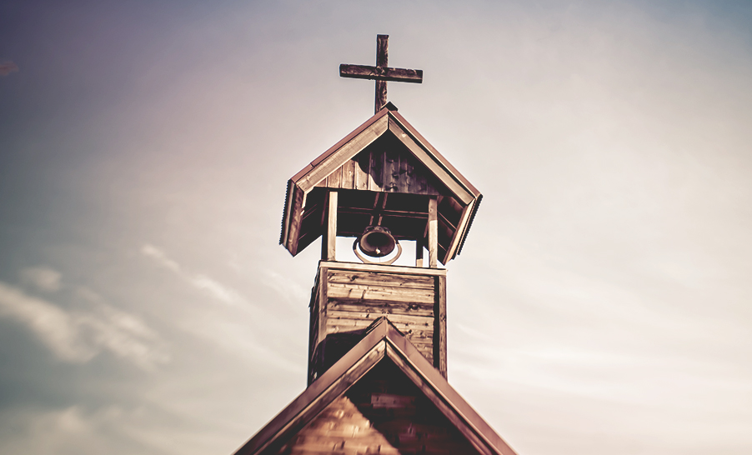
=
=
=

Slide 5
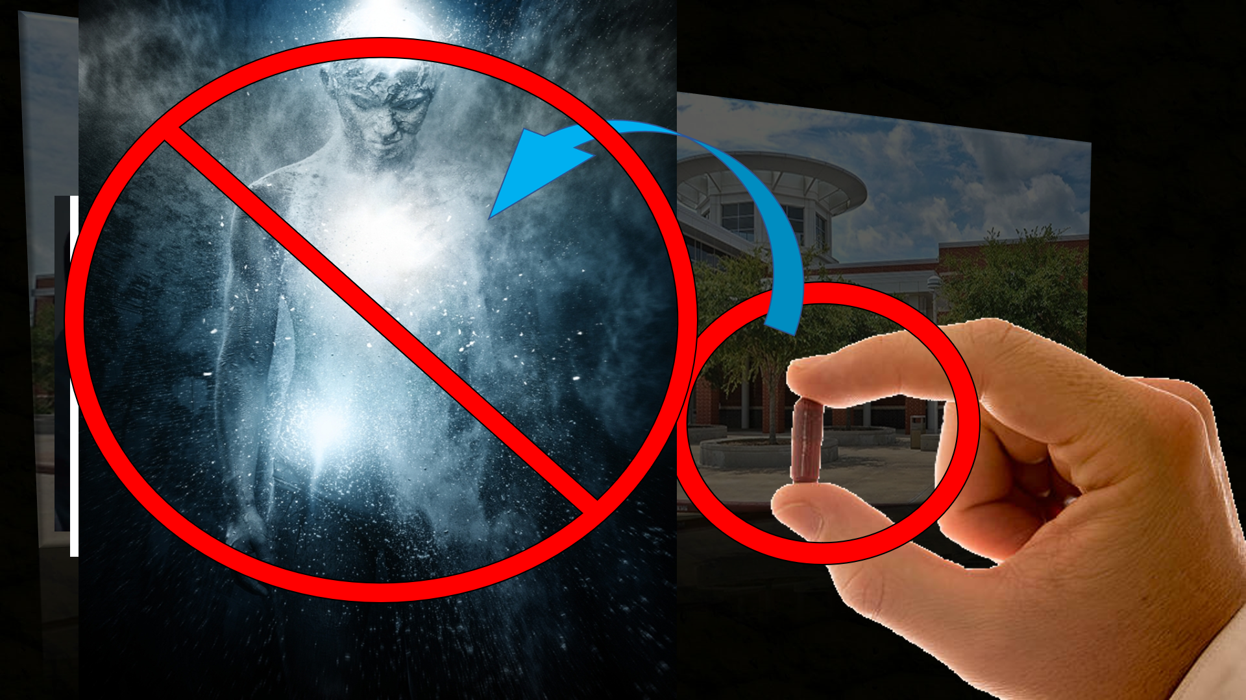
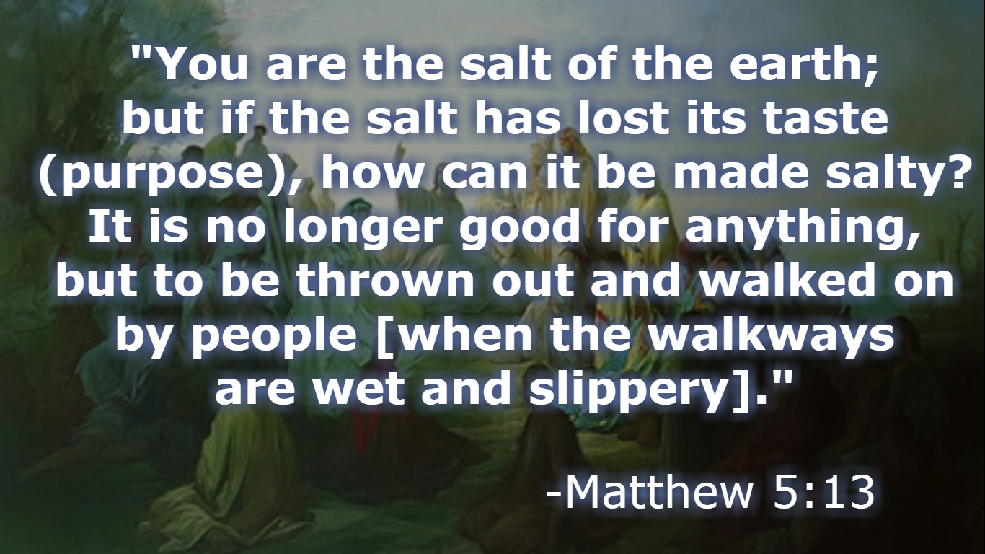
Worldview: NATURALISM
(stronghold)
The physical/material world is all that exists.
(Nothing more. Nothing less)

Slide 6
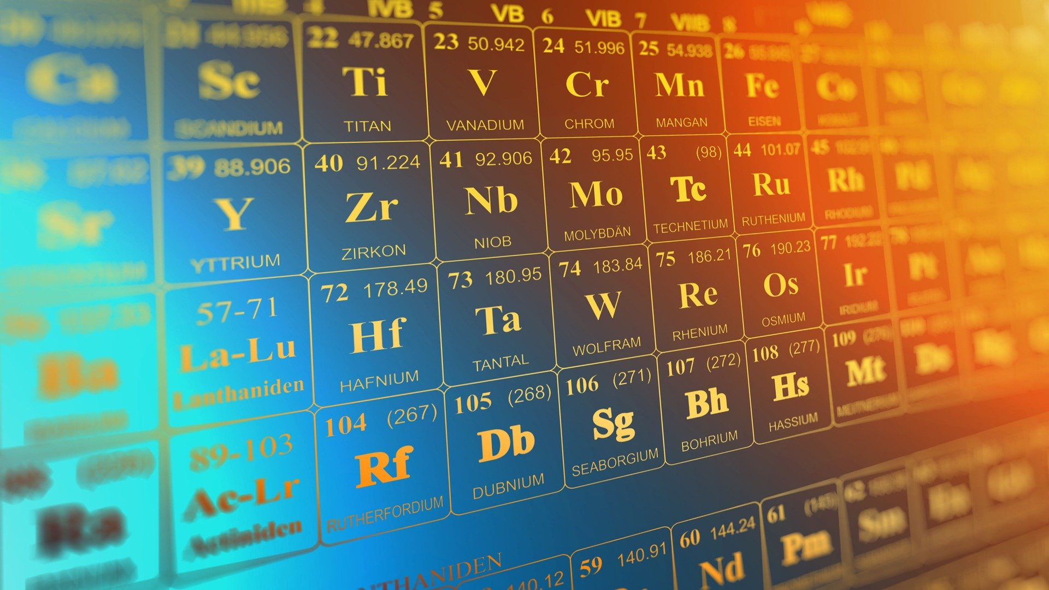

NATURALISM
Empiricism:
Knowledge senses
Only Science = knowledge (e.g. scientism)
Reductionism:
“Nothing but/more than…”
Everything that exists = explained and reduced physical
Physicalism:

Slide 7

NATURALISM
Empiricism:
Knowledge senses
Only Science = knowledge (e.g. scientism)
Reductionism:
“Nothing but/more than…”
Everything that exists = explained and reduced physical
Physicalism:
Human beings = purely physical objects
composed of purely physical properties and parts

Slide 8
NATURALISM
Empiricism:
Knowledge senses
Only Science = knowledge (e.g. scientism)
Reductionism:
=
Physicalism
“Nothing but/more than…”
Everything that exists = explained and reduced physical
Physicalism:
Human beings = purely physical objects
composed of purely physical properties and parts
(only physical substances exist)

Slide 9

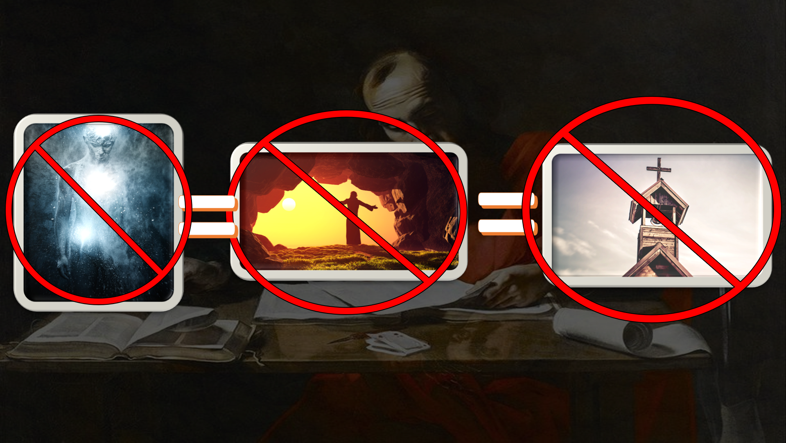


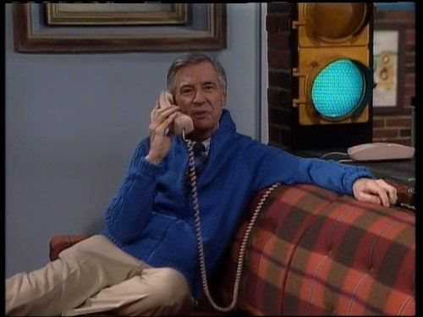

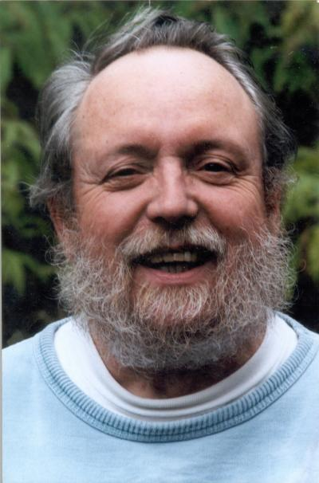
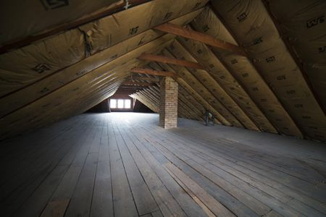
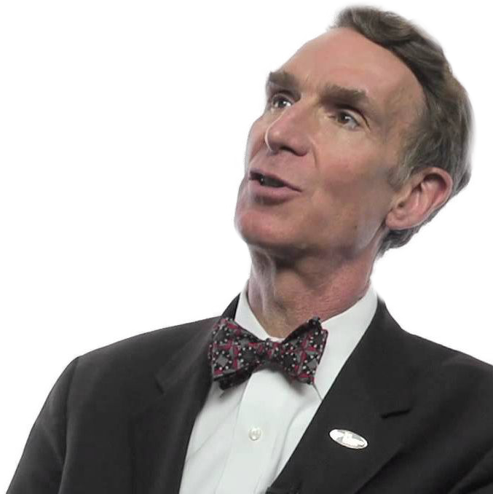


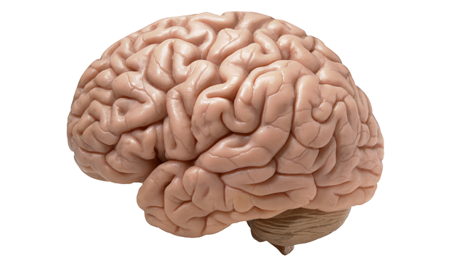

?
?
X
2 Basic points
An
immaterial substance
that
possesses consciousness and
animates the body
Science physical
“Science does not ask certain questions, so it is to no surprise that it does not give certain answers”
=
=
1.Consciousness physical
Soul
=
SCIENCE
Soul non-physical
2. I > and
-Atheist Philosopher of Science
Michael Ruse
(I am a soul)

Slide 10
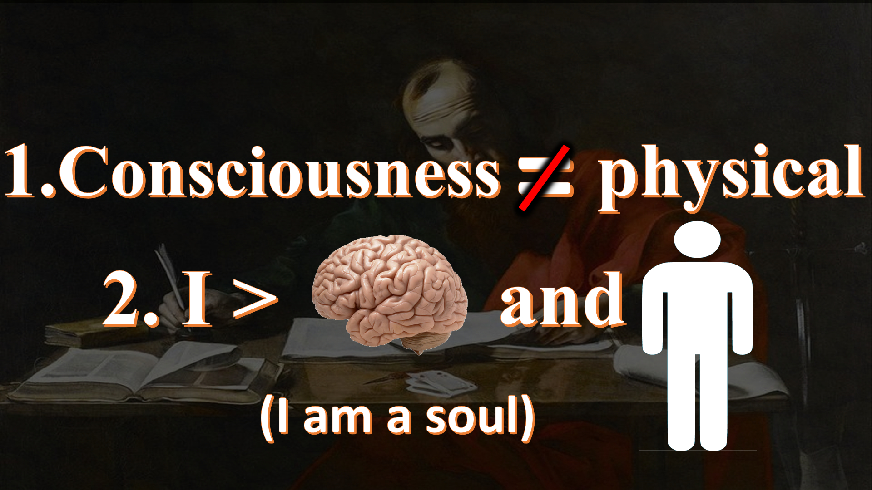
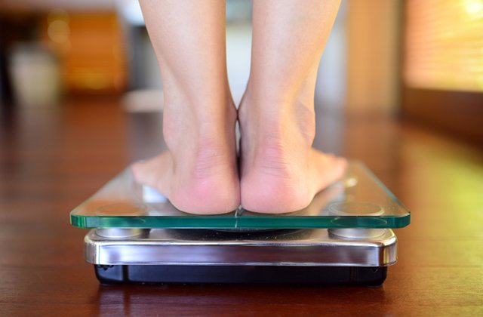



The Law of Identity
=
Science
A.
B.
Soul non-physical

Slide 11

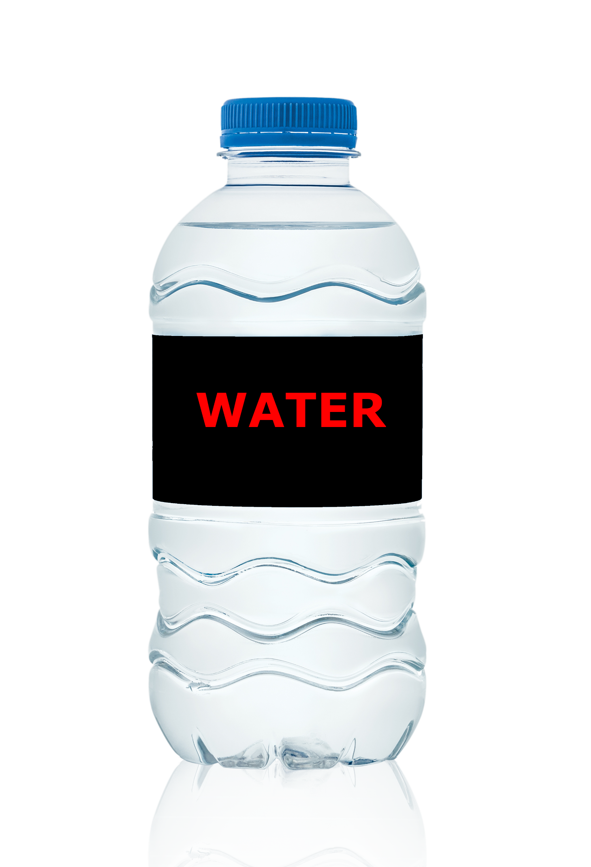
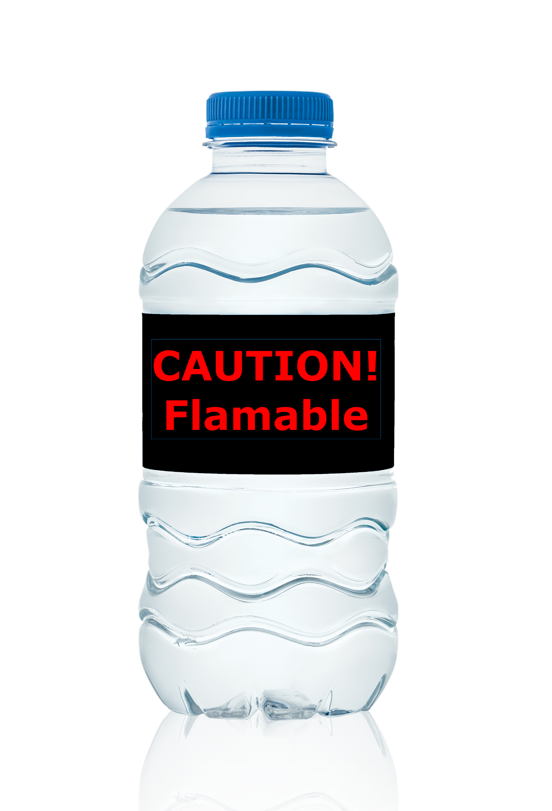
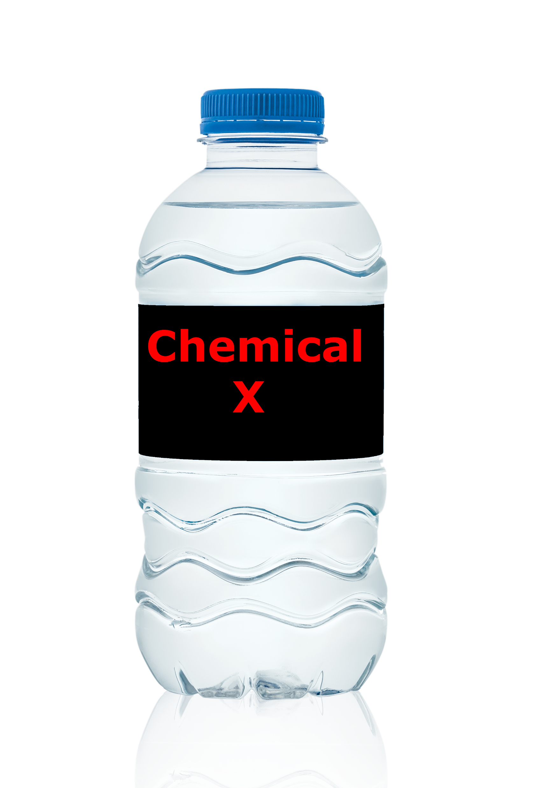
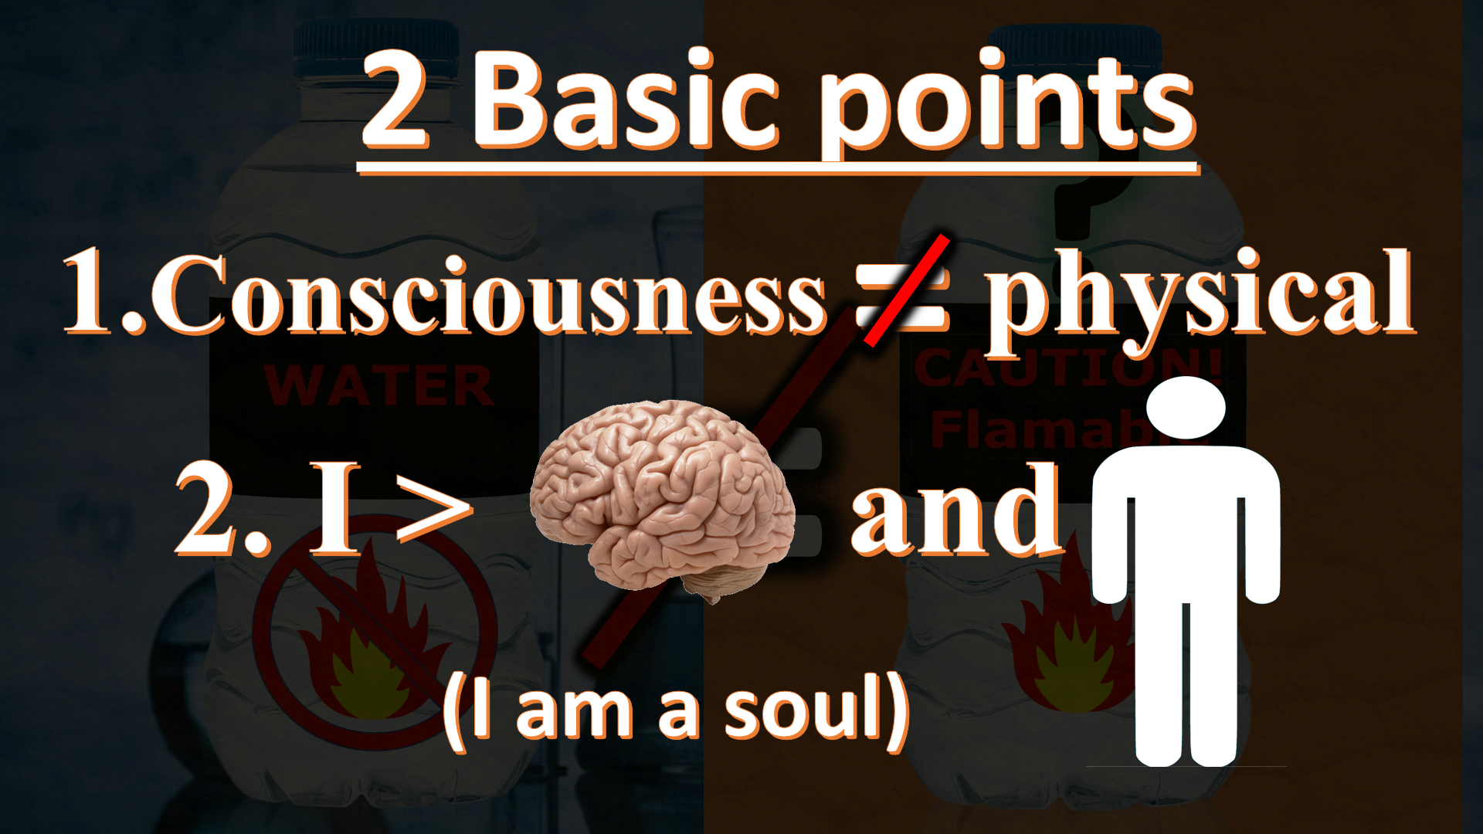
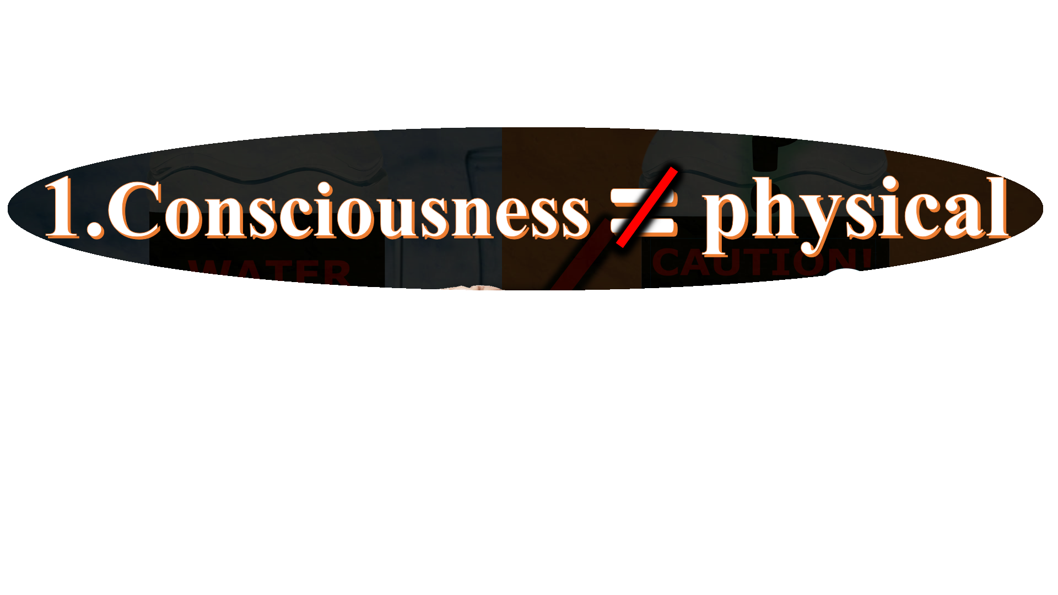
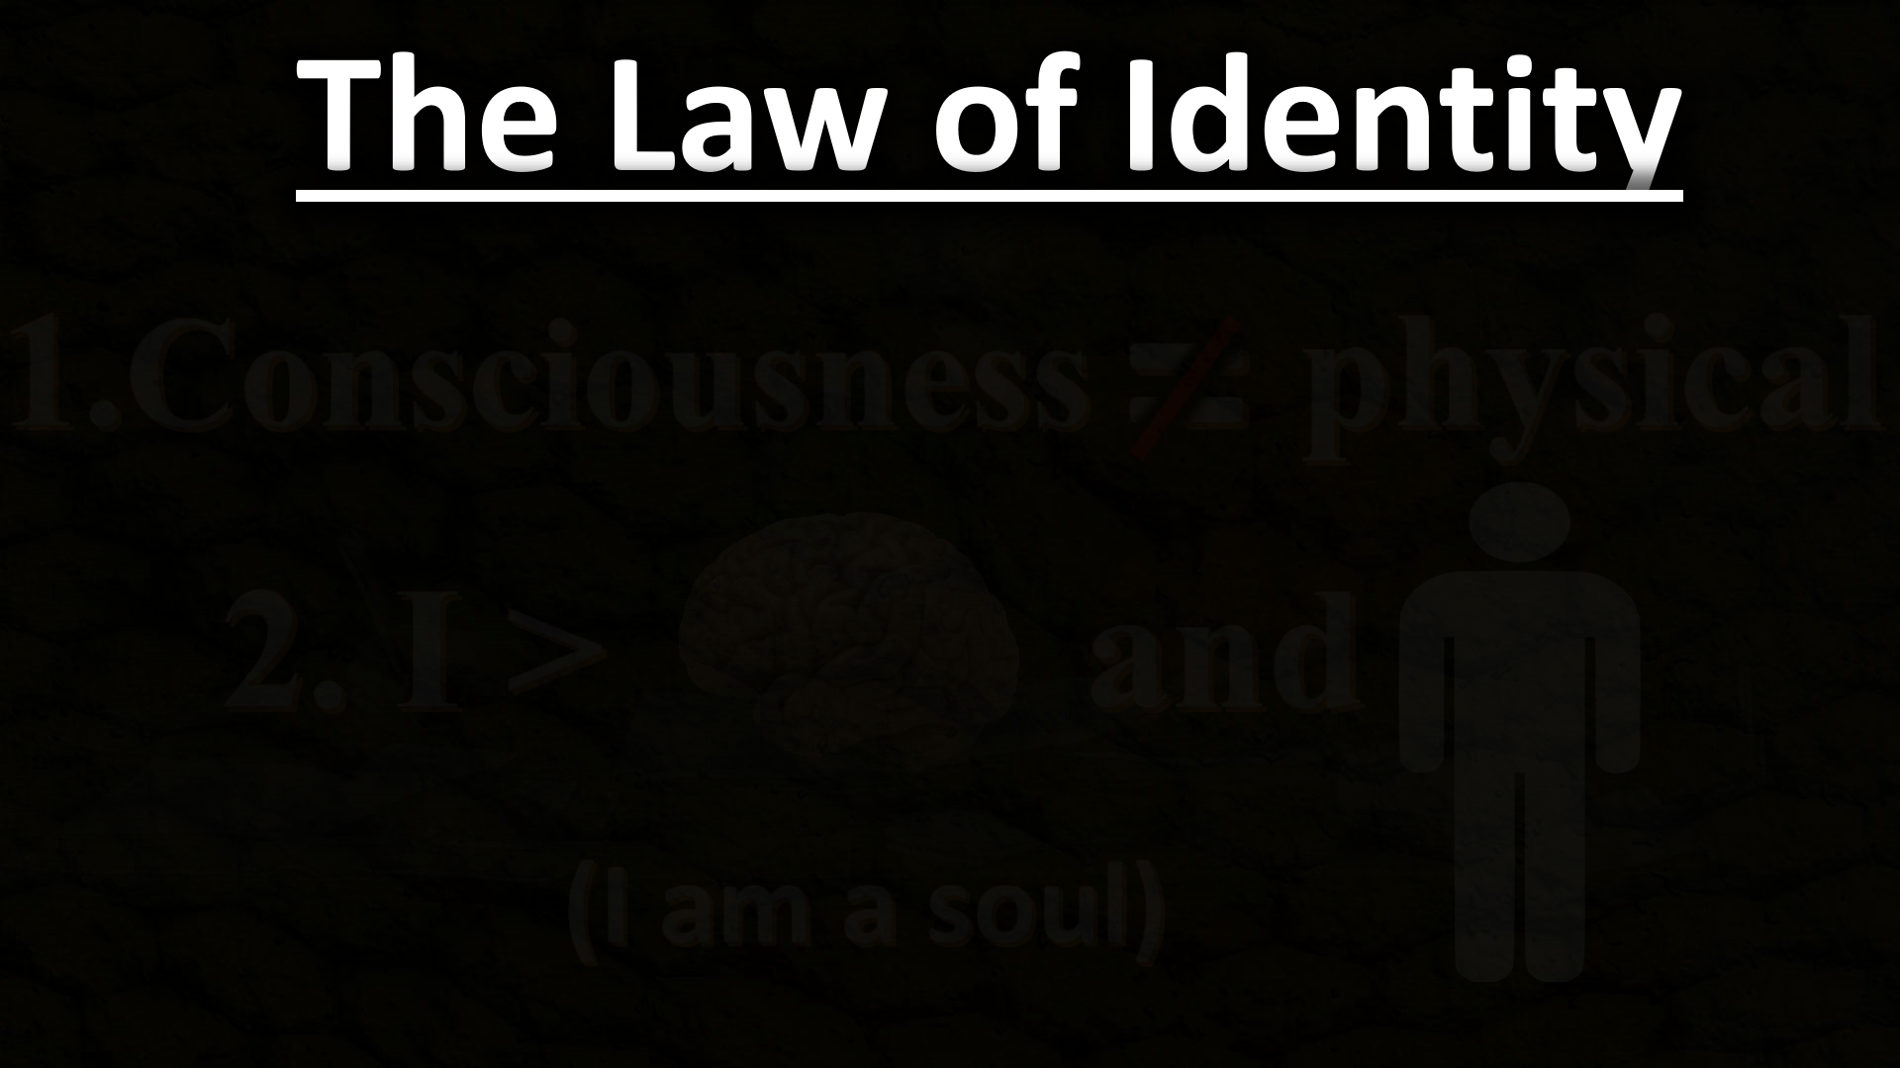


5 States
The Law of Identity
?
Thoughts
Beliefs
Sensations
Desires
Acts of will
(volition)
=
=
=
MIND
Consciousness(Mind)

Slide 12

Atheism
non-physical

Slide 13
If Atheism is true...
=
Consciousness

Slide 14
If Atheism is true...
?
?
?
=
Consciousness
Physical
?

Slide 15
=
MIND

Slide 16
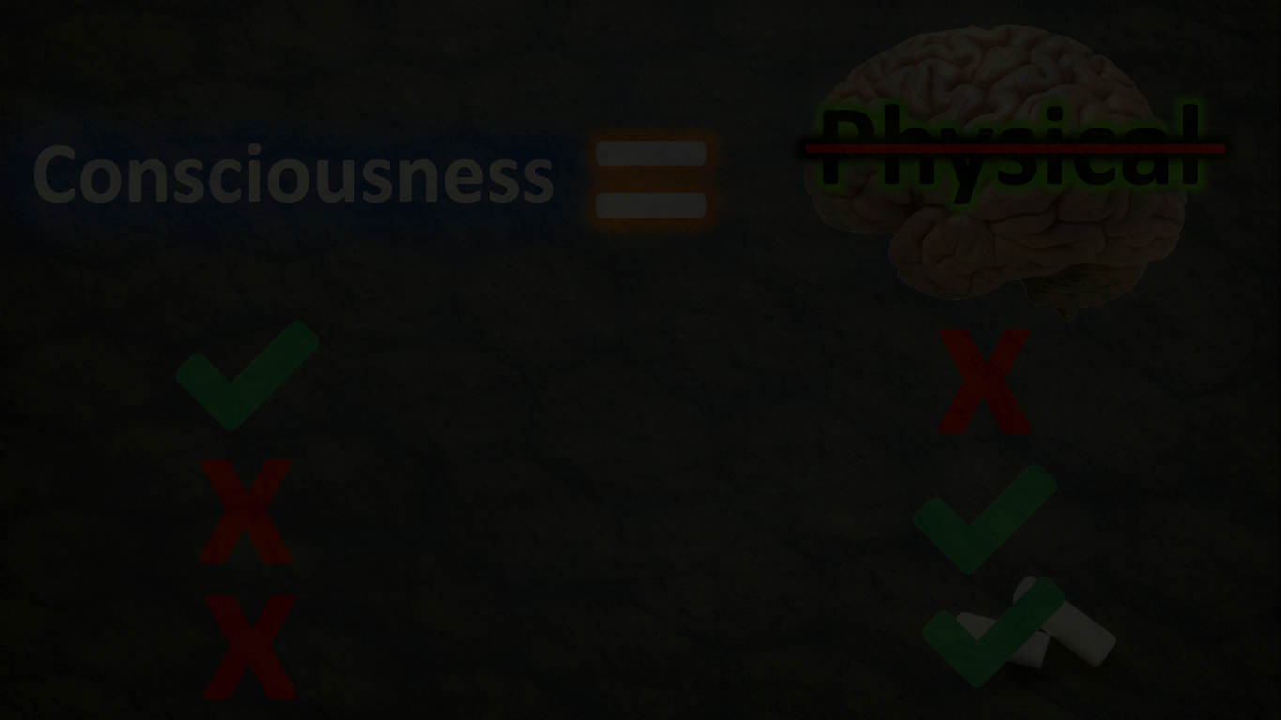
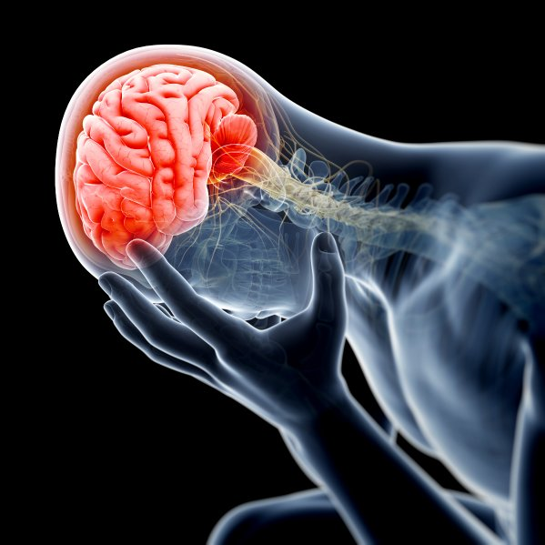
?
=
MIND
Physical
Non-Physical
Consciousness
=
Atheism
x
MIND
x
x

Slide 17
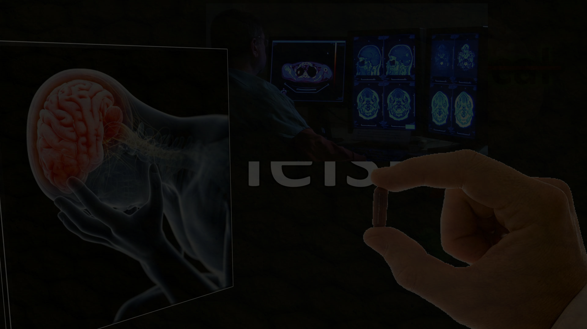
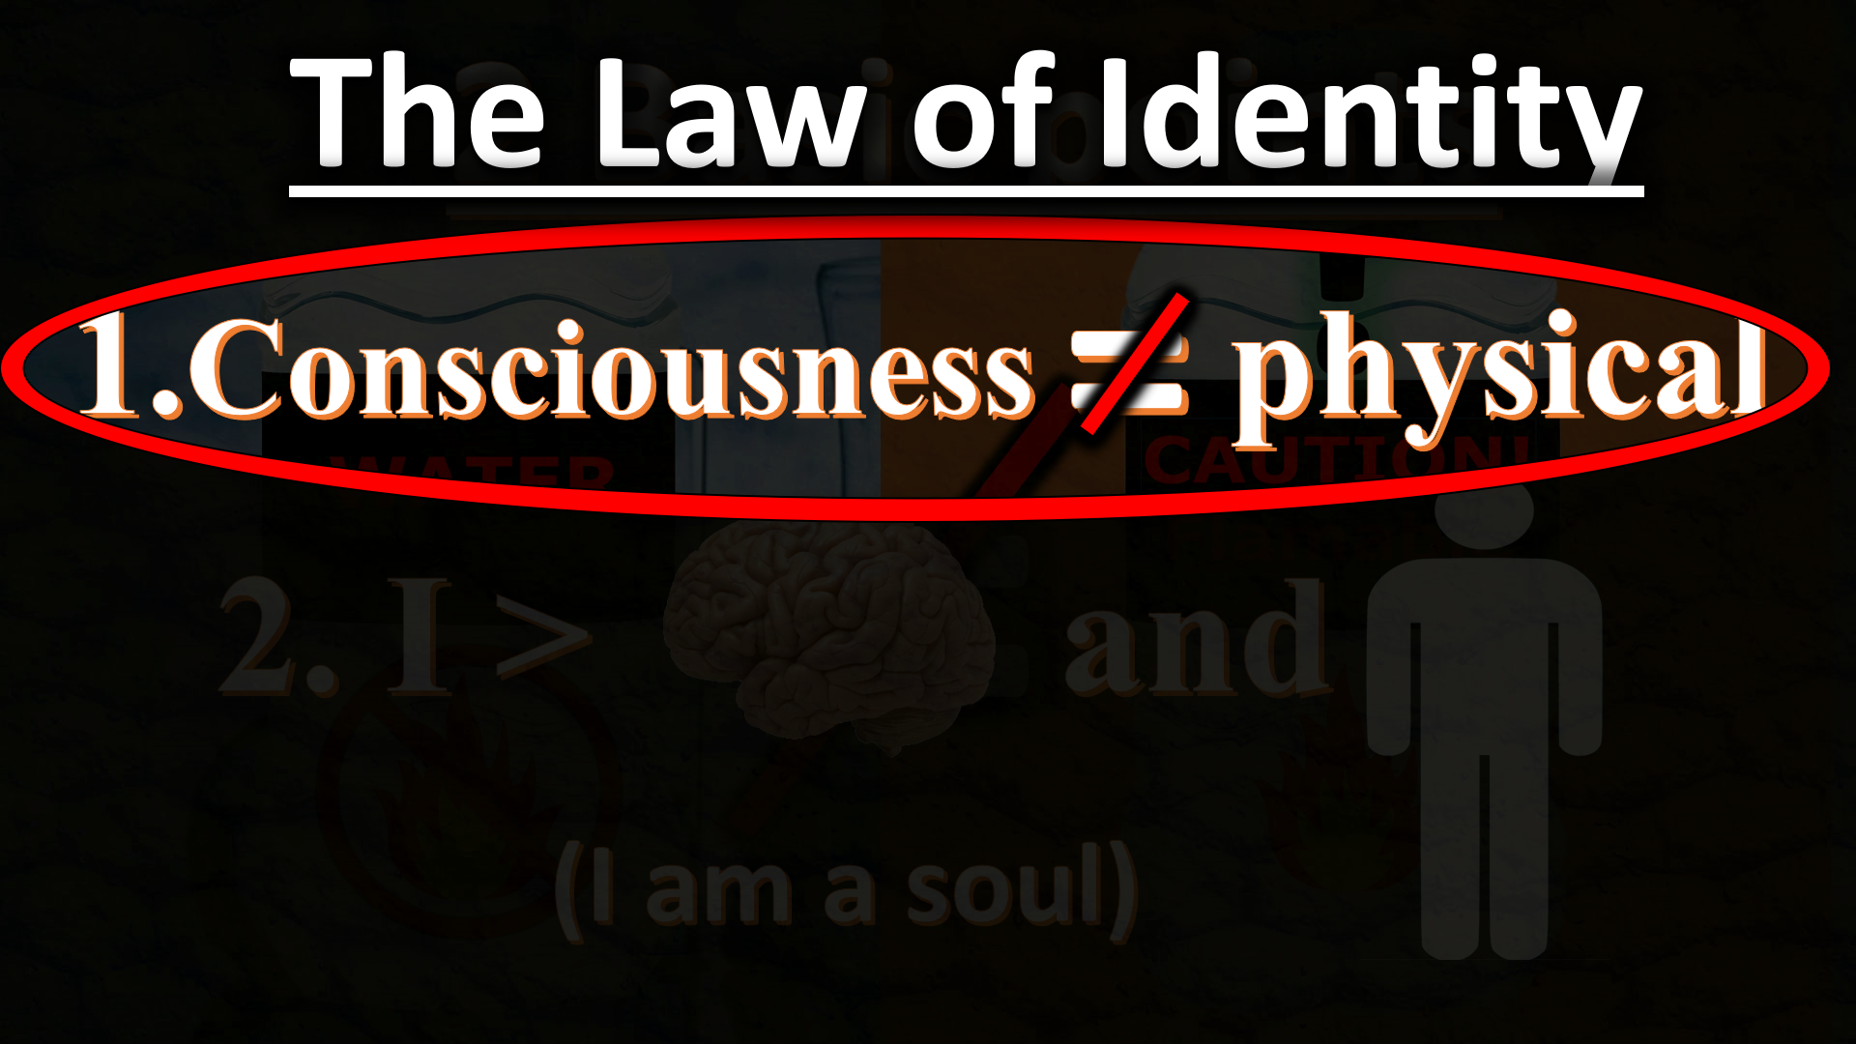





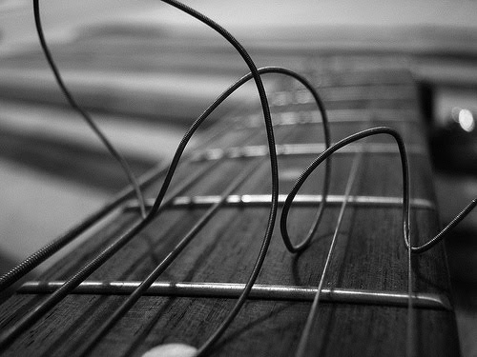
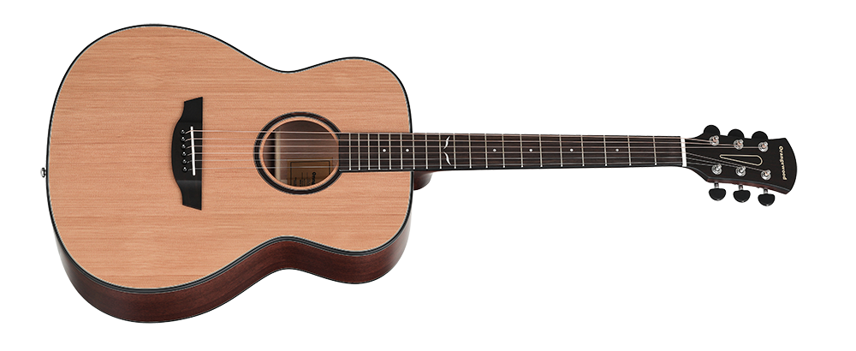
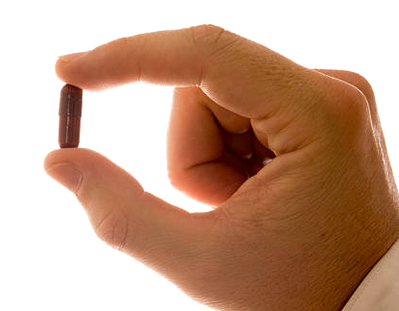
x
?
=
=
Consciousness
=
Cause
or
Dependence
Cause
or
Dependence
=
MIND
=
Thoughts
Beliefs
Sensations
Desires
Acts of will
Caused By
Identity
OR
Identity
=
?
Dependent On

Slide 18
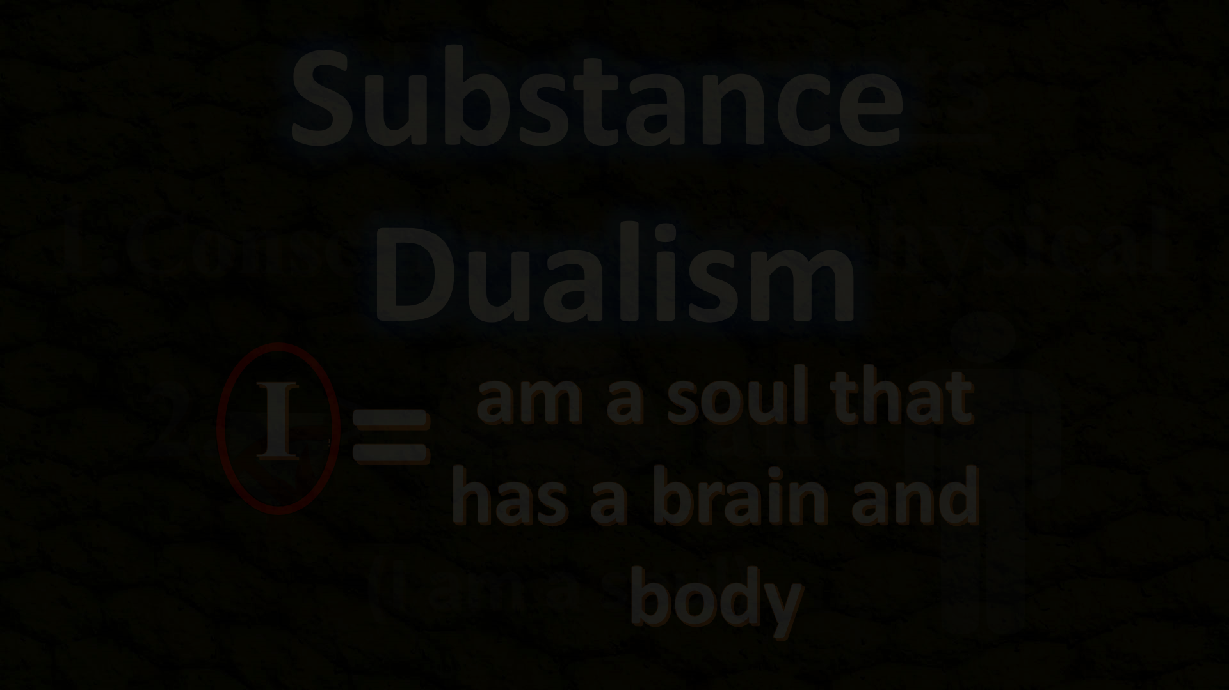
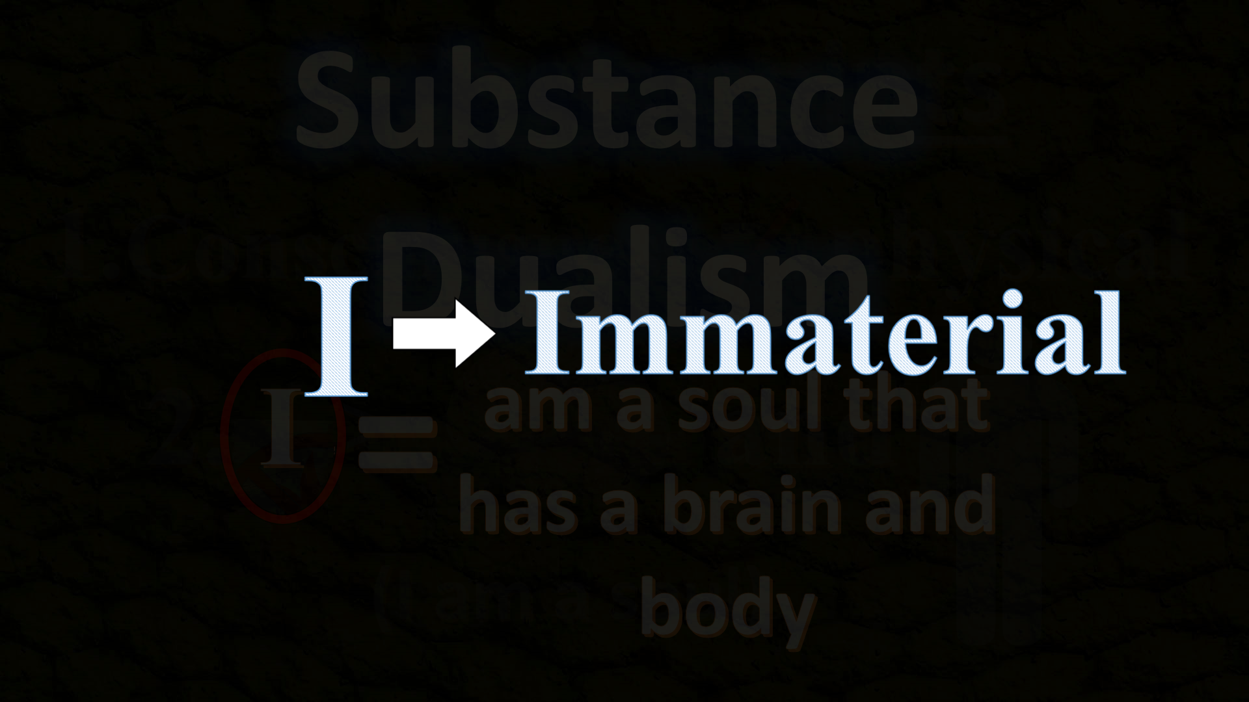




Then..
Then..
So, if
Substance
Dualism
And if..
I
=
I
I
Soul
Soul
Immaterial
Soul
Soul
=
Body
X
AM
“ ”
have a
+
=
Physical
=
=
am a soul that has a brain and body
+

Slide 19


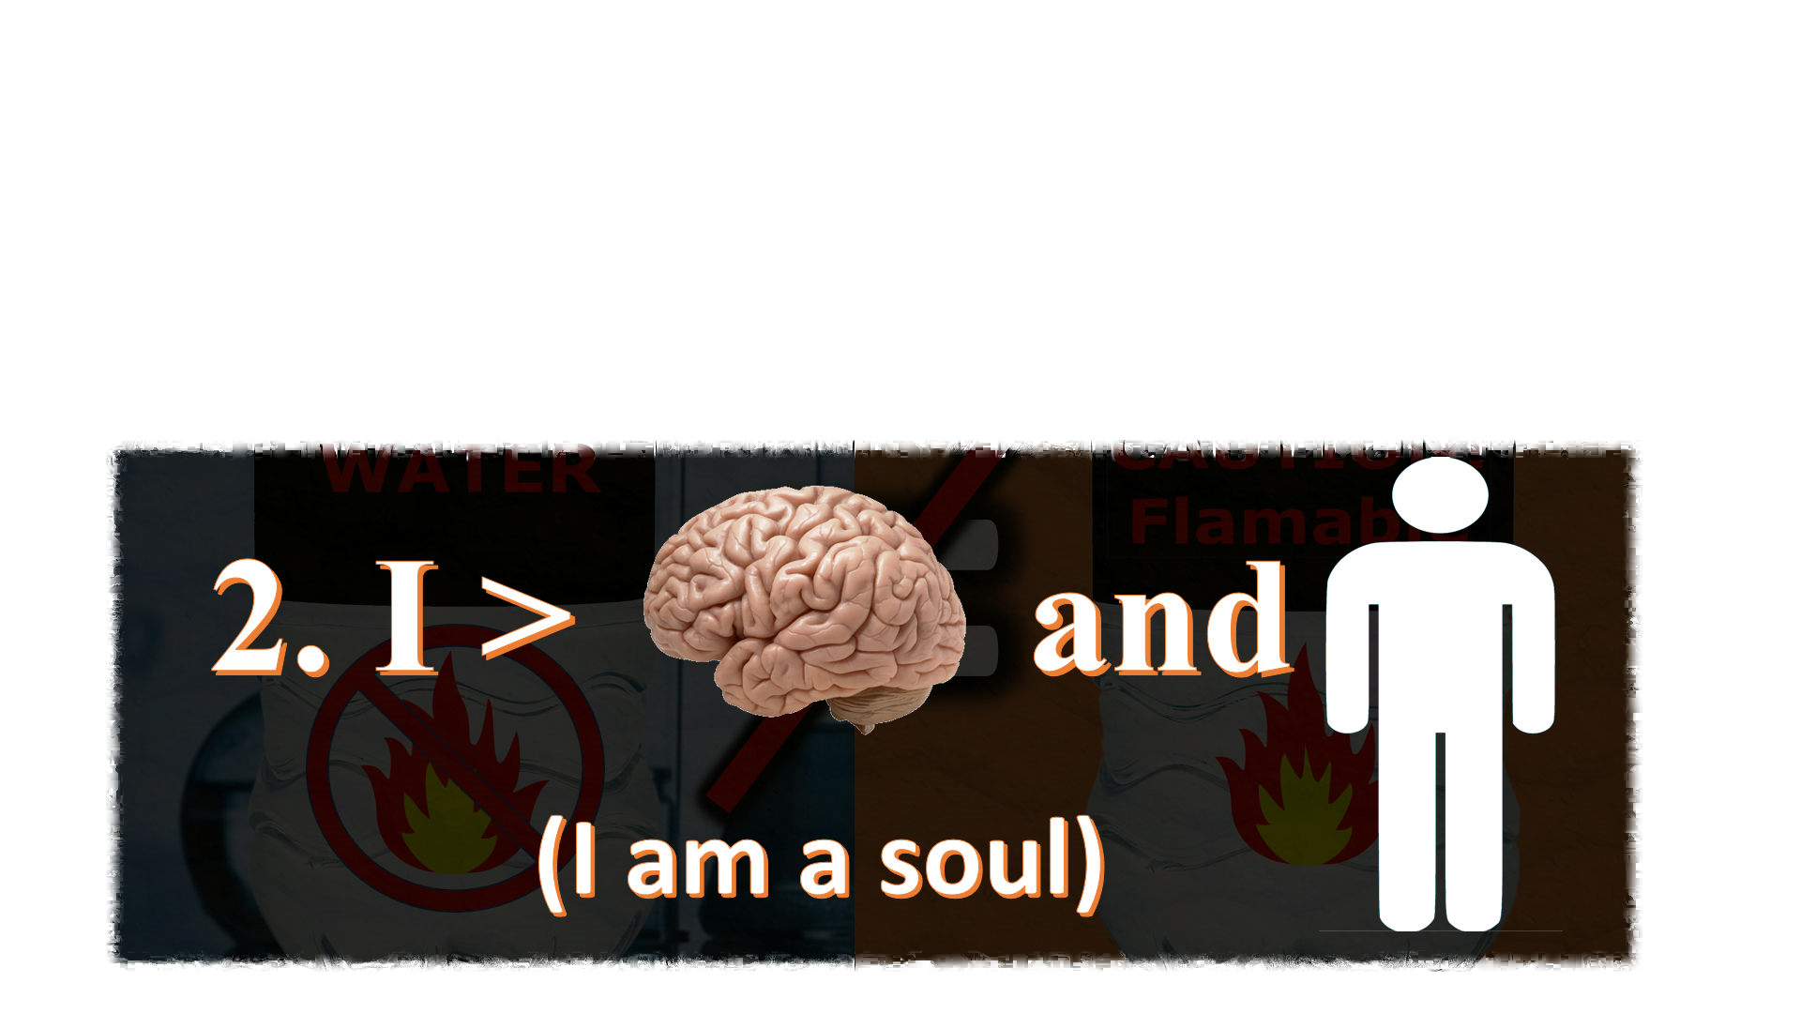
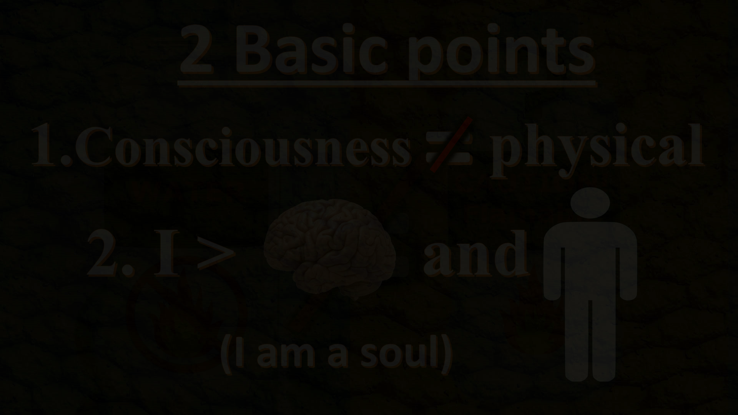
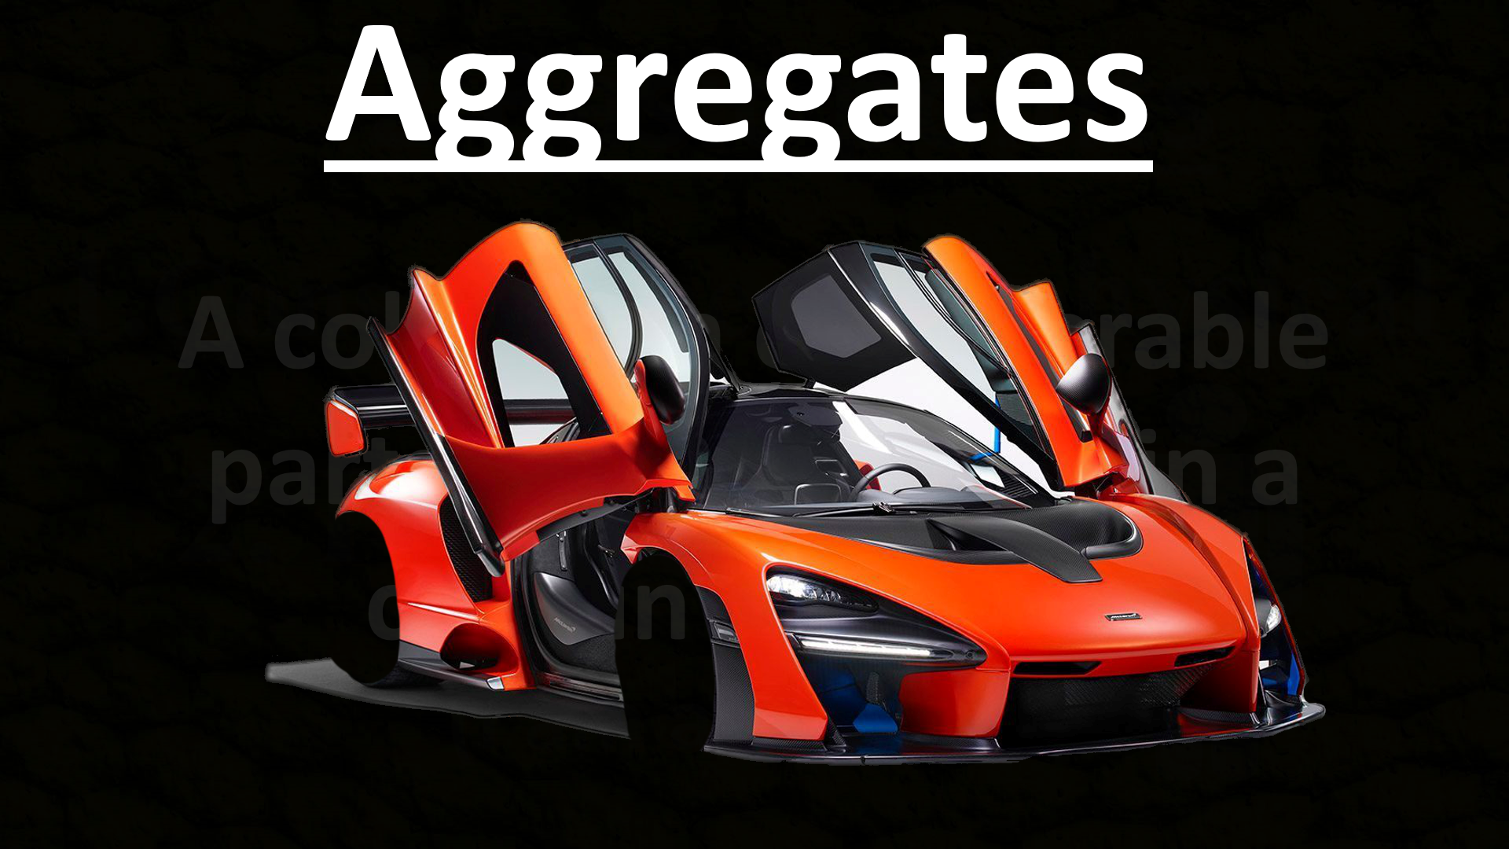
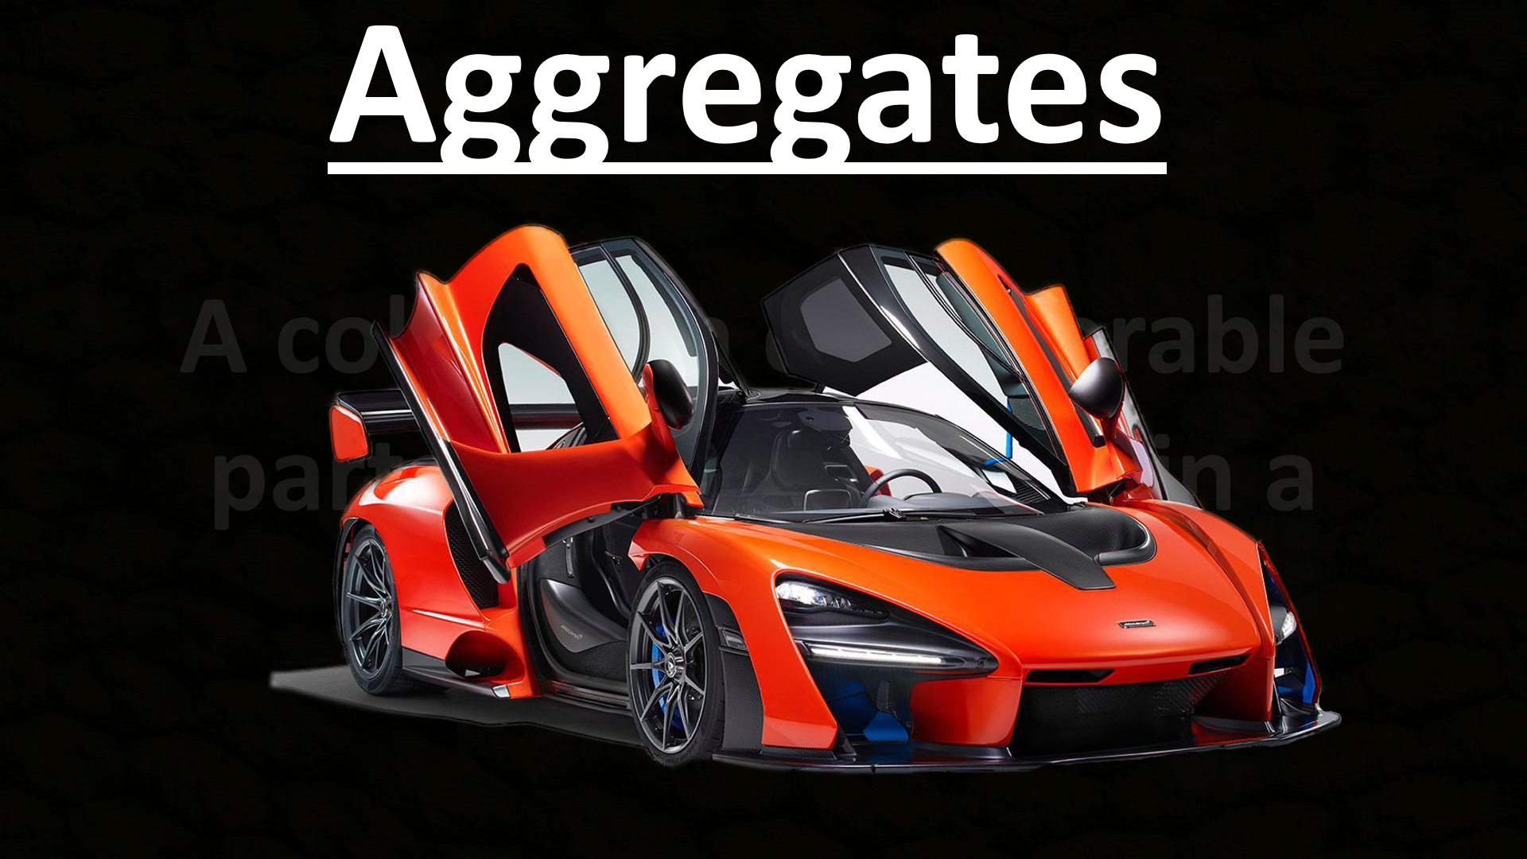
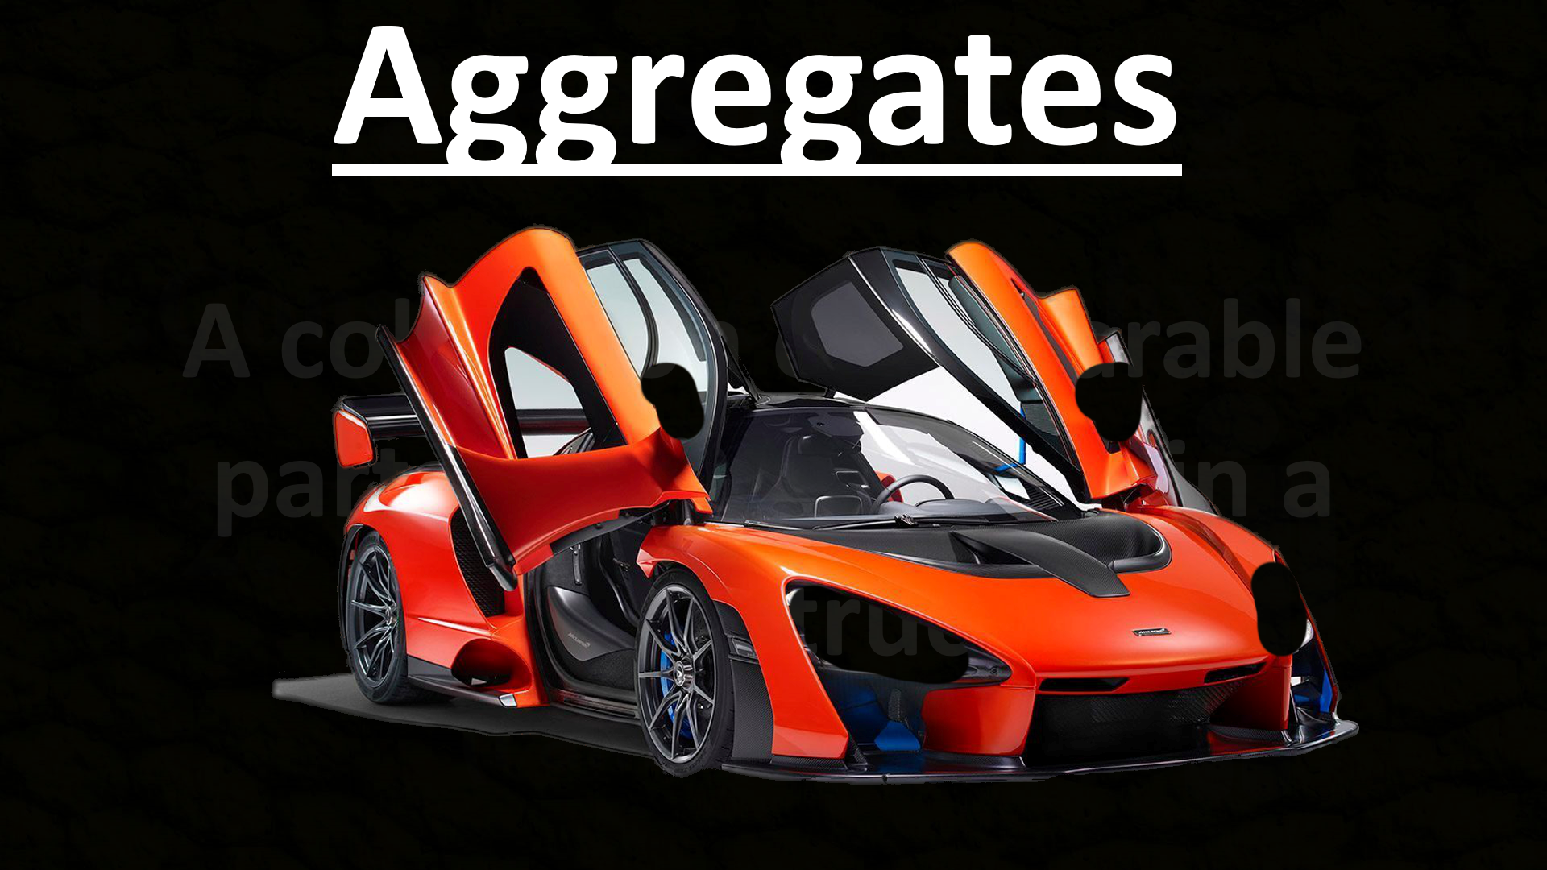
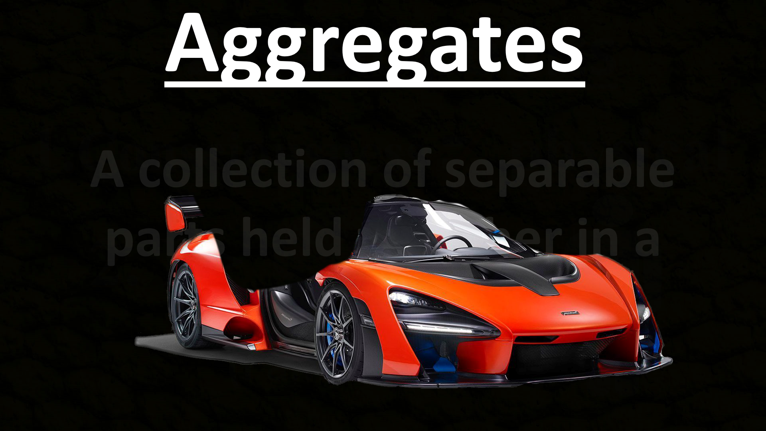
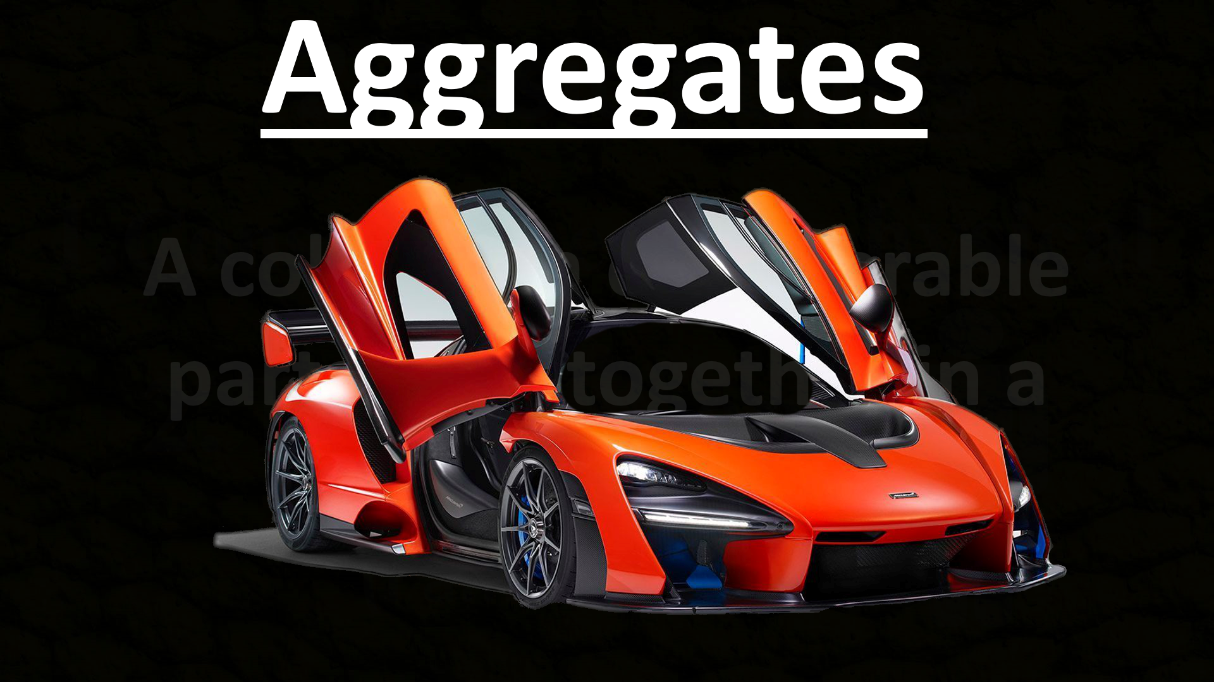
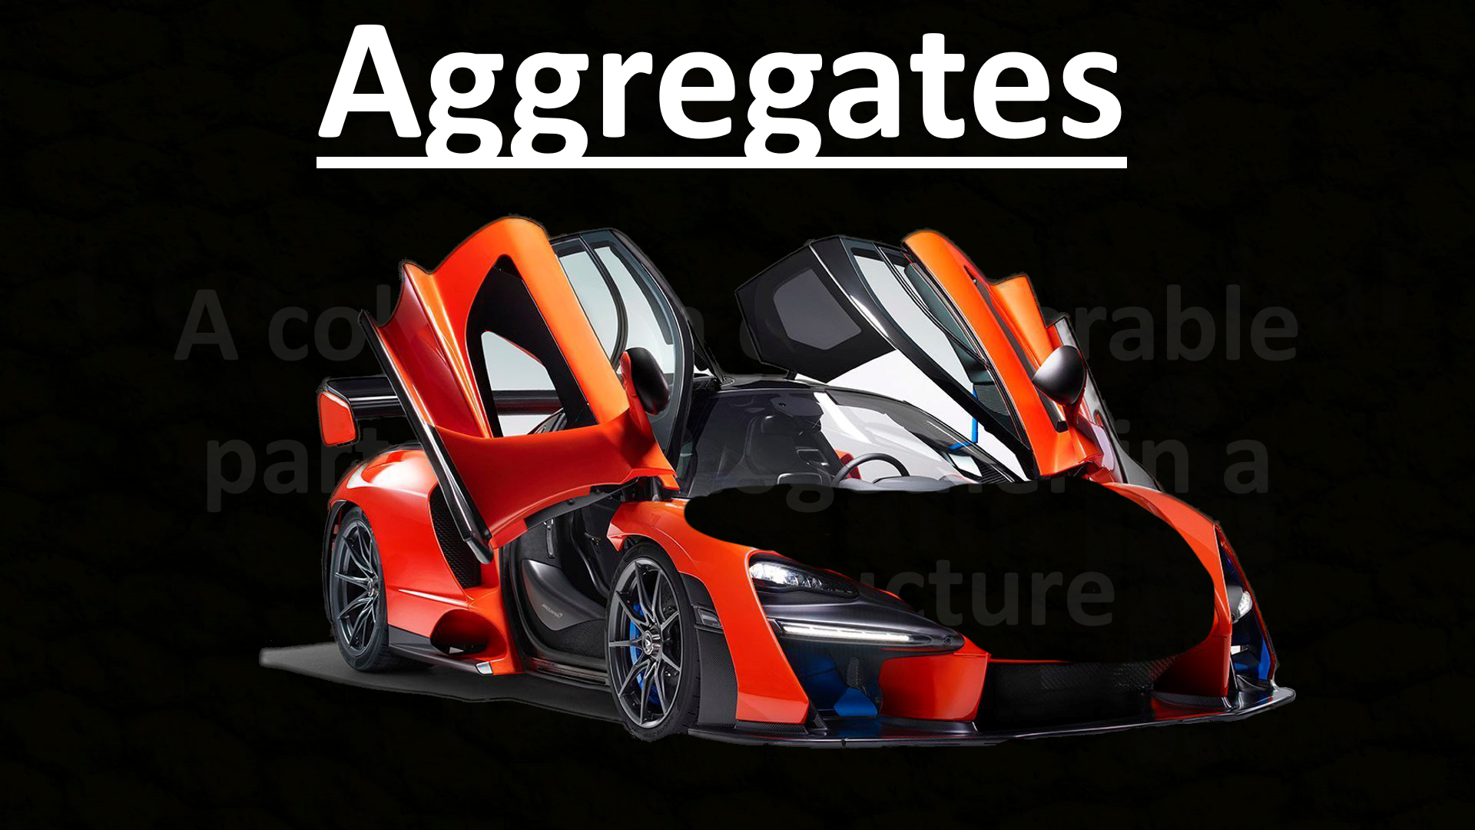
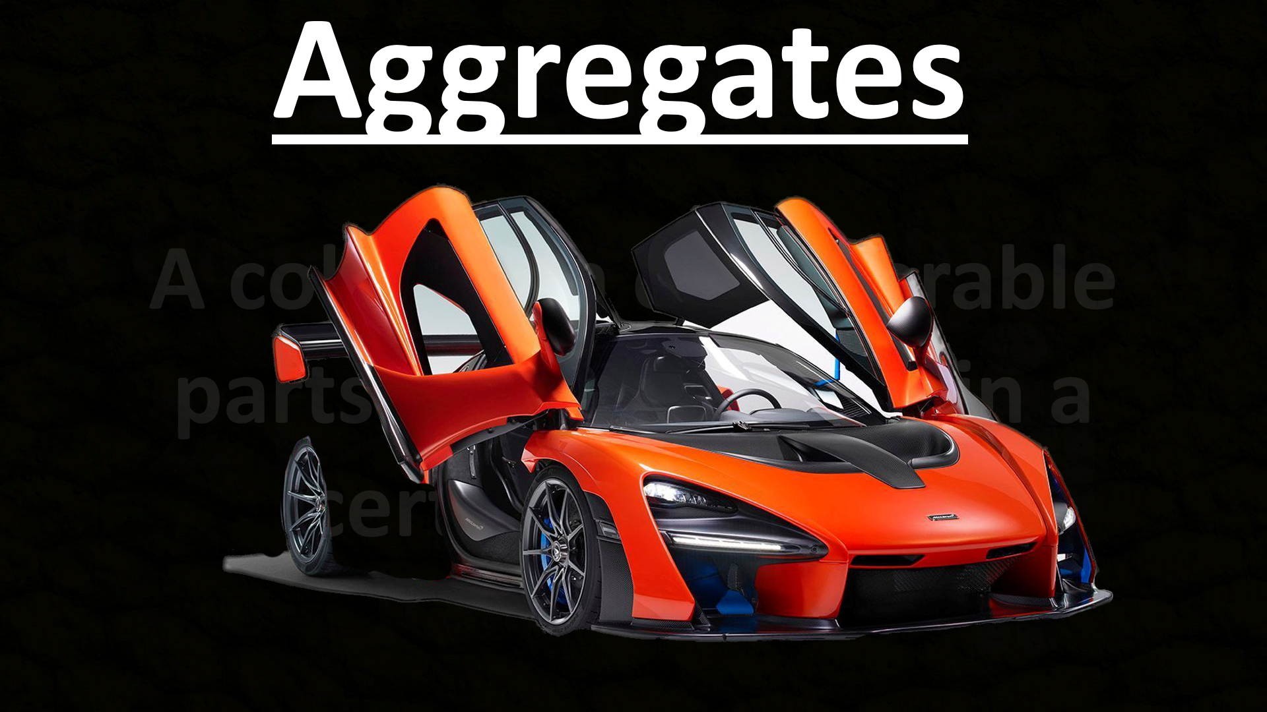
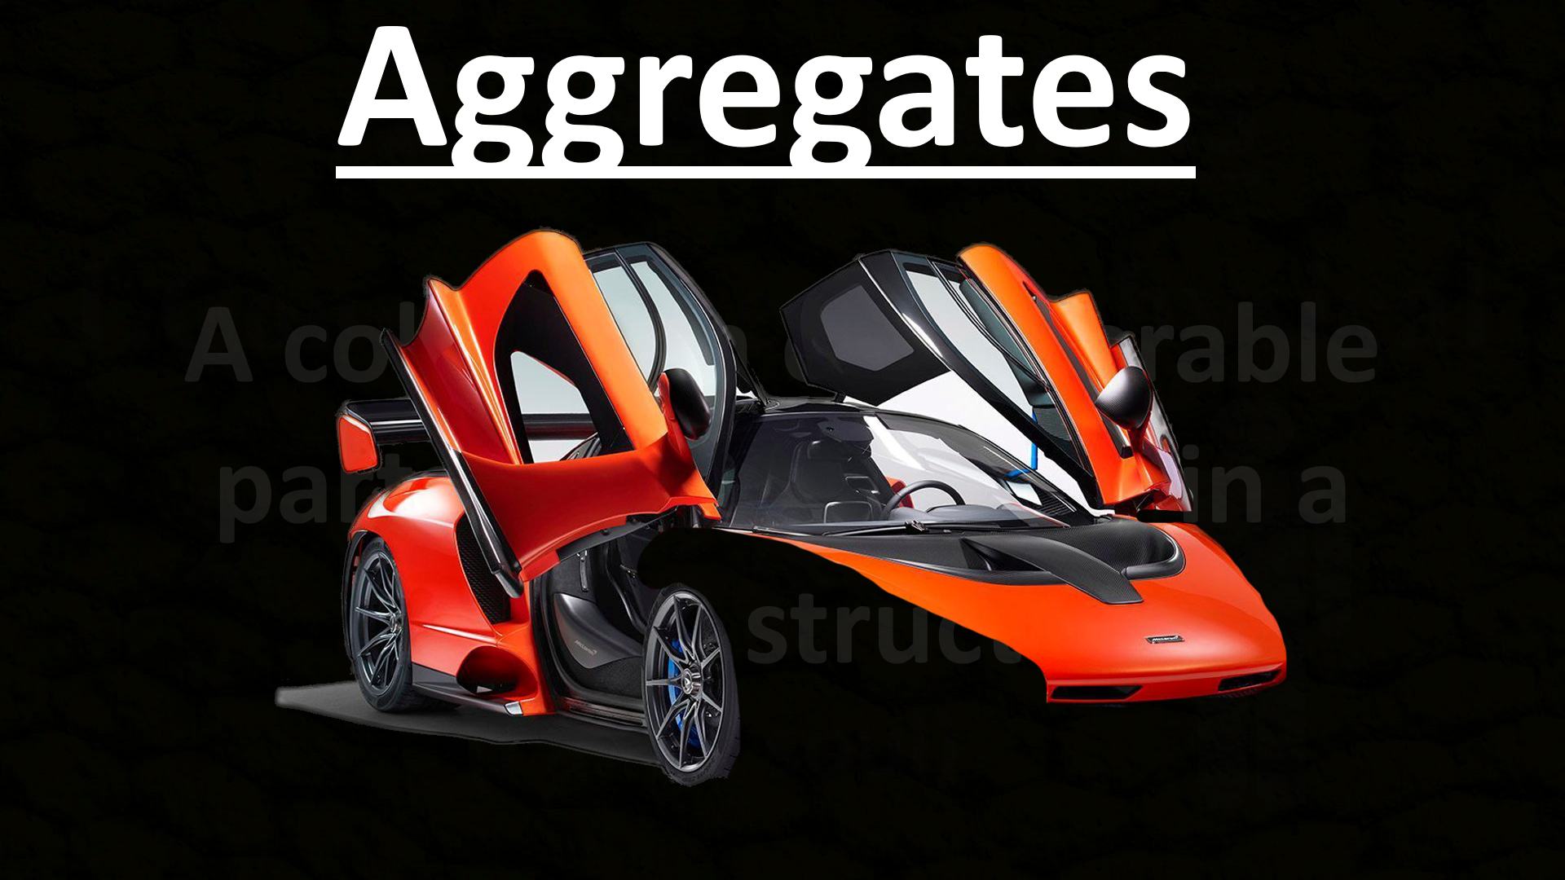



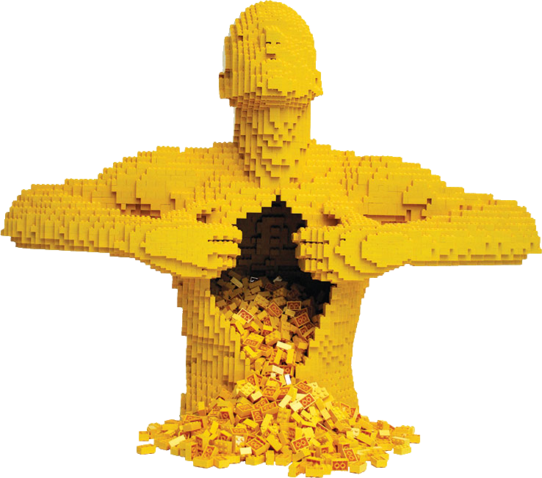
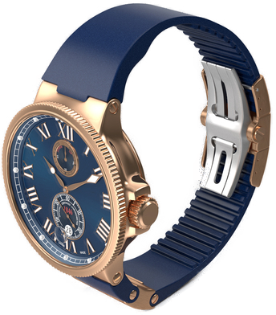


Aggregates
Mereological Aggregate
The Law of Identity
If…
A collection of separable parts held together in a certain structure
I
=
+

Slide 20


?
Identity through change

Slide 21



Argument:
Identity Through Change
1. I am either a purely physical object (aggregate)
or an immaterial soul.
2. If I am a purely physical object, then I do
not retain identity through change.
?

Slide 22
Argument:
Identity Through Change
1. I am either a purely physical object (aggregate)
or an immaterial soul
2. If I am a purely physical object, then I do
not retain identity through change.
3. I DO maintain identity through change!
4. Therefore, I am not a purely physical object.
5. Therefore, I am a soul

Slide 23















Argument:
:
:
Degreed
Properties
Non-Degreed
Properties
-Be divided
-Exist and vary in
percentages or degrees
“All or Nothing”
kind of thing
- Cannot Be divided
- Cannot exist in
percentages or
degrees
Indivisibility of Personhood
50%
50%
1. I am either a purely physical object (aggregate)
or an immaterial soul.
Even
-er
-er
Soft
Loud
2. Purely physical objects can be divided and exist
in various percentages or degrees.
Hard
-er
#
-er
#
Quiet

Slide 24
Argument:
Indivisibility of Personhood
1. I am either a purely physical object (aggregate)
or an immaterial soul
2. Purely physical objects can be divided and exist
in various percentages or degrees.
3. I cannot be divided or exist in percentages or degrees (I am an all or nothing kind of thing).
4. Therefore, I am not a purely physical object.
5. Therefore, I am a soul.

Slide 25






Argument:
?
Free Will
:
Being the original source/first mover of one’s will or actions.
(you are not caused to act or will by something prior or external to oneself)
First Cause
Secondary Causes

Slide 26







Argument:
Atheism
?
:
Soul
God
The Law of Causal Closure
Free Will
Every physical event MUST
have a physical cause
1. I am either a purely physical object (aggregate)
or an immaterial soul.
FREE WILL
(i.e. No God or Souls Can Be Involved)
2. If I am a purely physical object, then I do not
posses free will.
No Soul Needed!
First Cause

Slide 27


Atheism
:
The Law of Causal Closure
Every physical event MUST
have a physical cause

Slide 28








Option #1
2 Options
Soul
Soul
MUST be explained by some prior physical event
?
?
First Cause
FREE WILL

Slide 29



Option #1
Soul
Soul

Slide 30


Option #2
Soul
Soul
?
First Cause
--------
FREE WILL

Slide 31









Argument:
Free Will
1. I am either a purely physical object (aggregate)
or an immaterial soul.
2. If I am a purely physical object, then I do not
posses free will.
3. I DO possess free will.
4. Therefore, I am not a purely physical object.
FREE
WILL
Rational Responsibility
Soul
5. I am a soul

Slide 32











Moral Responsibility

Slide 33


Free Will
:
?
--------
First Cause
Secondary Causes

Slide 34



Soul
FREE
WILL
3. I DO possess free will.
4. Therefore, I am not a purely physical object.
5. Therefore, I am a soul.

Slide 35
EhmApologetics.org

Slide 36


Slide 37



Review:
Importance of the Soul
Love God with the mind
(intellect/faculty of understanding)
1)
=
=
Christianity
is false
No soul
no resurrection
2)

Slide 38


5 States
The Law of Identity
Review:
Existence of the Soul
2 Basic points
Thoughts
Beliefs
Sensations
Desires
Acts of will
(volition)
Defined:
=
=
1.Consciousness physical
An immaterial substance that
contains consciousness and
animates the body
Consciousness(Mind)
=
2. I > and
MIND
Cause or
Dependence
=
(I am a soul)
Identity

Slide 39

2. I > and
1) Identity Through Change
2) Indivisibility of Personhood
- Rational Responsibility
- Moral Responsibility
Soul
3) Freewill

